Slide 1
Metabolism of Xenobiotics
Ms. Arati Gupta

Slide 2
Xenobiotics
Xenobiotic (Gk xenos "stranger") are compounds which may be accidently ingested or taken as drugs or compound produced in the body by bacterial metabolism.
Xenobiotics can produce a variety of biological effects including-
Toxicity
Immunological responses
Cancers

Slide 3
CHARACTERISTICS OF XENOBIOTICS
Most xenobiotics are:
Lipophillic
Penetrate membranes by diffusion
Transported by lipoproteins in blood
Require chemical conversion to facilitate excretion

Slide 5
Biotransformation Reactions
A process whereby a substance is changed from one chemical to another chemical by a chemical reaction within the body.
Consequences
Changes in solubility characteristics
Detoxification
Metabolic activation

Slide 6
Biotransformation
Potentially toxic xenobiotic
prodrug
Detoxification
Metabolic activation
Inactive metabolite
Reactive intermediate

Slide 7
Detoxification Reactions
Biochemical reactions involved in the conversion of foreign, toxic and water insoluble molecules to non toxic, water soluble and excretable forms are called Detoxification reactions
Purpose
Converts lipophilic to hydrophilic compounds
Facilitates excretion

Slide 8
Metabolism of Xenobiotics
Two phase of metabolism
Phase 1
Phase 2
Alteration of xenobiotic molecule so as to add a functional group, which can be conjugated in phase 2.
Compounds produced in
phase 1 are converted
by specific enzymes to
various polar metabolites
by conjugation.
They become more water soluble and easily excretable.

Slide 9
Phase 2
Phase 1
Oxidation
Reduction
Hydrolysis
Deamination
Dehalogenation
Desulfuration
Epoxidation
Peroxygenation
Glucuronic acid
Sulfate, acetate,
Glutathione
Certain amino acids
By methylation.

Slide 11
Role of Liver
Main organ involved
Hepatocytes contain wide variety of enzymes to process
xenobiotics
Enzymes are present in endoplasmic reticulum and to
lesser extent in other organelles
Each enzyme represents a large family of gene product
Each gene product may be induced by different
xenobiotics

Slide 12
Phase I reactions
Phase I reactions include:
Oxidation
Reduction
Hydrolysis reactions

Slide 13
Oxidation
Oxidation of Alcohols- Primary aliphatic and aromatic alcohols are
oxidized to corresponding acids. Two enzymes are involved in this process : alcohol dehydrogenase oxidizes alcohol to aldehyde; and aldehyde dehydrogenase oxidized aldehyde to acid.
Methanol Formaldehyde Formic acid
Ethanol Acetaldehyde Acetic acid Benzoyal Alcohol Benzaldehyde Benzoic acid

Slide 14
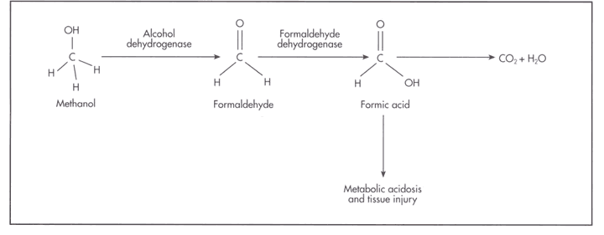
It is an example of Entoxification

Slide 15
Reduction
The major group of compounds which are reduced and detoxified by the liver are nitro compounds.
Nitro compound are reduce to their amines, while aldehydes or ketones are reduced to alcohols.
Examples: Picric acid → picramic acid
Para-nitrophenol → para-aminophenol

Slide 16
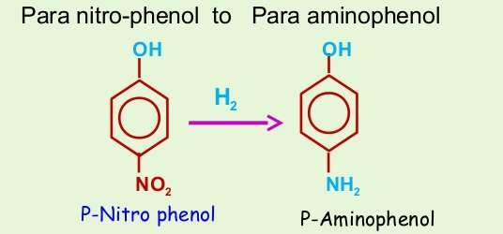
Reduction

Slide 17
Hydrolysis
Hydrolysis is a chemical reaction in which the addition of water splits the toxicant into two fragments or smaller molecules.
The hydroxyl group (OH-) is incorporated into one fragment and the hydrogen atom is incorporated into the other.
Ester, amines, hydrazines, amide, glycosidic bonds and carbamates are generally biotransformed by hydrolysis, e.g. aspirin, acetanilide, procaine, xylocaine, aliphatic ester etc

Slide 18
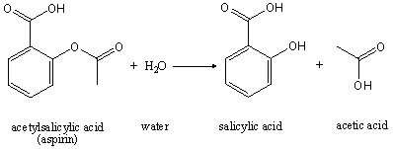
Hydrolysis

Slide 19
Phase 1 reactions- Enzymes
Mainly Catalyzed by a class of enzymes referred to as Monooxygenases, Mixed Function oxidases or Cytochrome P450s.
Other enzymes of significance are-
Aldehyde and alcohol dehydrogenase
Deaminases
Esterases
Amidases
Epoxide hydrolases

Slide 20
Cytochrome P450 Enzyme system

Slide 21
Properties of Human Cytochrome P450s
They are heme- containing enzymes, localized in the endoplasmic reticulum of liver.
Involved in phase I of the metabolism of innumerable xenobiotics.
Involved in the metabolism of many endogenous compounds.
They catalyze reactions involving introduction of one atom of oxygen into the substrate and one into water.

Slide 22
Exhibit broad substrate specificity, thus act on many compounds.
Extremely versatile catalysts, perhaps catalyze about 60 types of reactions.
Liver contains highest amounts, but found in most if not all tissues, including small intestine, brain, and lung.
Located in the smooth endoplasmic reticulum.

Slide 23
In some cases, their products are mutagenic or carcinogenic.
Many have a molecular mass of about 55 kDa.
Many are inducible, resulting in one cause of drug interactions.
Many are inhibited by various drugs or their metabolic products, providing another cause of drug interactions.
Some exhibit genetic polymorphisms, which can result in atypical drug metabolism.

Slide 24
Phase 2 - Conjugation
These reactions involve covalent attachment of small polar endogenous molecule such as glucuronic acid, sulfate, or glycine to form water-soluble compounds.
Conjugation reactions can occur independently or can follow phase 1(hydroxylation) reactions.
Conjugation takes place primarily in liver but can occur in kidney also.
After conjugation the products are generally rendered non toxic but in certain conditions they are left unchanged or become more toxic.

Slide 25
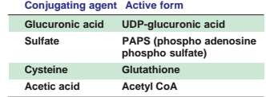

Slide 26
Glucuronidation
Sulfation
Acetylation
Methylation
Conjugation with Amino acids
Conjugation with G-SH

Slide 27
Glucuronidation
Glucuronidation is the most frequent conjugation reaction.
UDP-glucuronic acid , is the Glucuronyl donor, which is formed in the Uronic acid pathway of Glucose metabolism
Glucuronyl Transferases, present in both the endoplasmic
reticulum and cytosol, are the catalysts.
The glucuronide may be attached to oxygen, nitrogen, or sulfur groups of the substrates.

Slide 28
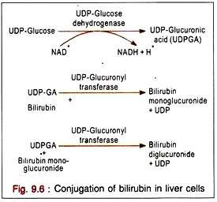

Slide 29
Sulfation
The sulfate donor is Phospho adenosine phospho sulfate (PAPS) this compound is called "active sulfate“
The enzyme is sulfo transferase
Compounds which are conjugated with sulphate are
as follows-
Phenols
Cresols
Indole
Steroids
R-OH + PAPS → R-O-SO3 + PAP
Phenol + PAPS → Phenyl sulfate + PAP

Slide 30
Acetylation
Acetylation is represented by
where X represents a xenobiotic.
Acetyl-CoA (active acetate) is the acetyl donor.
These reactions are catalyzed by acetyltransferases
Compounds conjugated by Acetylation
PABA (Para Amino Benzoic Acid)
Isoniazid

Slide 31
Conjugation with Amino acids
Conjugation with Glutamine
Phenyl Acetic acid + Glutamine
Phenyl Acetyl Glutamine
This reaction is important in patients of Phenyl ketonuria, since excess of Phenyl acetyl glutamine is excreted in urine, that imparts a mousy odor to the urine.

Slide 32
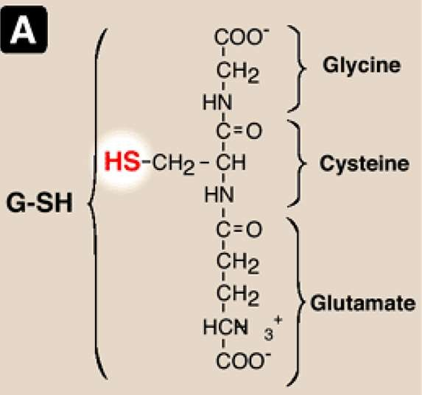
Conjugation with glutathione
structure

Slide 33
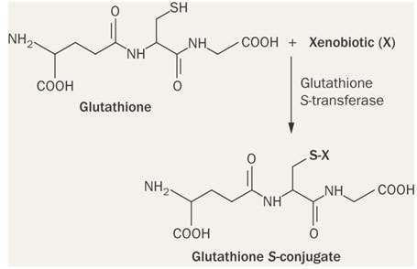

Slide 34
Methylation
Amino, hydroxy or thiol groups are methylated.
S-adenosyl methionine (SAM) is the methyl
donor.
The enzyme is O- methyl transferase.
Example: catechol-O-methyl transferase
converts epinephrine to metanephrine.
However, methylation decrease water solubility rather than increasing it. Metals like mercury may be methylated, making them more lipophilic, increasing permeablity and causing neurotoxicity.

Slide 35
Phase III – further modification and excretion
Conjugates and their metabolites can be excreted from cells in phase III of their metabolism.
A common example is the processing of glutathione conjugates to acetylcysteine (mercapturic acid) conjugates.

Slide 36
Role of Xenobiotics in Disease
Xenobiotics disrupt mitochondrial function and cause free oxygen radical and free nitrogen radical formation.
As ATP production decrease in mitochondrial dysfunction causes fatigue and weakness.
Xenobiotics produces variety of biological effects, including toxicity, immunological reaction and cancer.
Covalent binding of xenobiotics metabolites to macromolecules including DNA, RNA and protein can lead to cell injury and ultimately to death of cell.

Slide 37
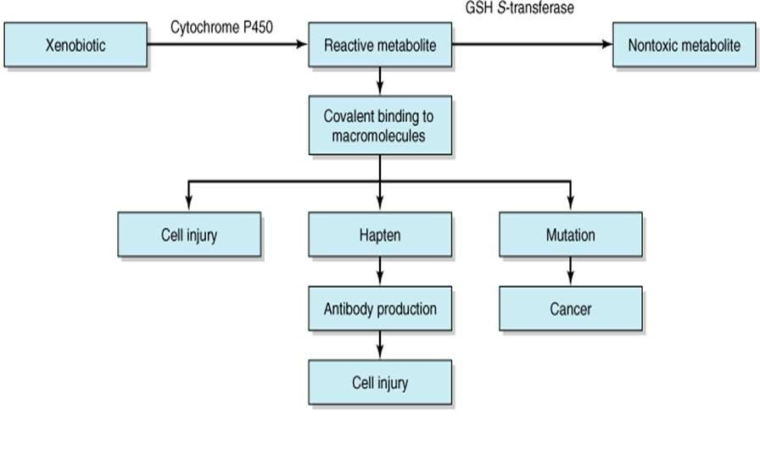
Effects of Xenobiotics

Slide 38
