Slide 1
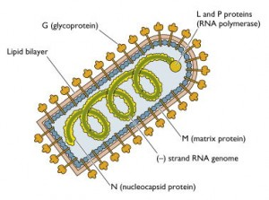
Rabies Rhabdovirus

Slide 2
Early Rabies
It has been recognized in India since the Vedic period (1500–500 BC) and is described in the ancient Indian scripture Atharvaveda,
Rabies is endemic in India, a vast country with a population exceeding 1.02 billion and a land area of 3.2 million km.

Slide 4
What is Rabies
Rabies is a zoonotic disease (a disease that is transmitted to humans from animals) that is caused by a virus. Rabies infects domestic and wild animals, and is spread to people through close contact with infected saliva (via bites or scratches). The disease is present on nearly every continent of the world but most human deaths occur in Asia and Africa (more than 95%). Once symptoms of the disease develop, rabies is fatal.

Slide 5
Rabies
Rhabdovirus family; genus Lyssavirus
Enveloped, bullet-shaped virions
Slow, progressive zoonotic disease
Primary reservoirs are wild mammals; it can be spread by both wild and domestic mammals by bites, scratches, and inhalation of droplets
5
Notes:
5

Slide 6
Rhabdovirus
A Bullet shaped virus/ Enveloped
Contains single stranded RNA virus
Rhabdoviridae – infects mammals.
Important virus
Lyssa virus- Rabies virus
Lyssa means Rage.

Slide 7
Rabies virus
Bullet shaped virus
Size is 180 x 75 nm
Has Lipoprotein envelop
Knob like spikes /Glycoprotein G
Genome un segmented
Linear negative sense RNA

Slide 8
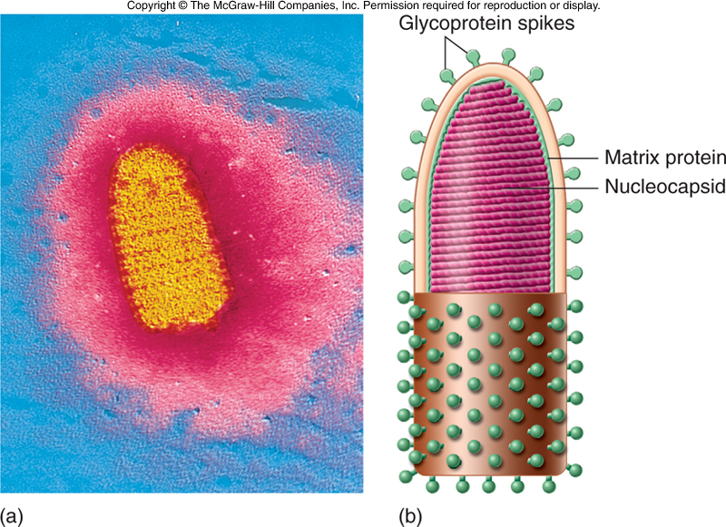
Structure of the rabies virus
Insert figure 25.8
Structure of rabies virus
8
Notes:
8

Slide 9
Fixed Virus
One whose virulence and incubation period have been stabilized by serial passage and remained fixed during further transmission.
Rabies virus that has undergone serial passage through rabbits, thus stabilizing its virulence and incubation period,Negri bodies usually not found, used for vaccine productiion

Slide 10
Street Virus
Virus from a naturally infected animal, as opposed to a laboratory-adapted strain of the virus
The virulent rabies virus from a rabid domestic animal that has contracted the disease from a bite or scratch of another animal.

Slide 11
Any mammal can get rabies.
Raccoons, skunks, foxes and bats
Dogs, cats, cattle and ferrets
Humans
Notes:
Question for the students: What is a mammal?
Answer:
Warm-blooded
Has a backbone
Has fur
Offspring born live (as opposed to hatching from an egg)*
Females have mammary glands for feeding young
Note: the kids always know this!!
*Sometimes kids know that there are 2 mammal species that lay eggs rather than delivering live offspring. These are the Platypus and the Echidna (pronounced “EE-KID-NAH”). Both are native to Australia.

Slide 12
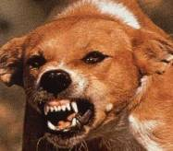
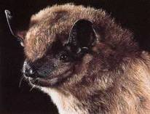
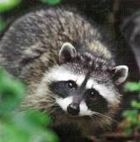
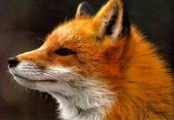
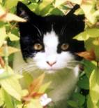
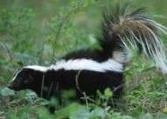
What kind of animals get rabies?
The rabies virus can infect all mammals.
Mammals are warm-blooded animals that have hair and mammary glands to produce milk for their babies.
Animals like frogs, birds, and snakes do not get rabies.
Notes:
12
What kinds of animals get rabies?
The rabies virus can infect all mammals.
Mammals are warm-blooded animals that have hair and mammary glands to produce milk for their babies.
The animals that can transmit rabies may vary based on where you live (geographic location).
Some of the common animals that can transmit rabies include dogs, bats, raccoons, foxes, cats, and skunks.
The primary cause of human rabies worldwide is from dogs.
In a country like the United States, where rabies in dogs has been controlled due to vaccinations, the primary cause of rabies in humans is from wildlife (particularly bats).
Resources
CDC Rabies Web site: www.cdc.gov/ncidod/dvrd/rabies/Epidemiology/Epidemiology.htm

Slide 13
Mans best friend but can spread Rabies if not vaccinated

Slide 14
Resistance
The virus is sensitive to
Ethanol
Iodine
Soap / Detergents
Ether, Chloroform, Acetone
Destroyed at 50⁰ c in 1 hour
at 60⁰ c in 5 minutes.

Slide 15
Antigenic properties
Surface spikes composed of Glycoprotein G
Produces Pathogenicity by binding to Acetyl choline receptors in the neural tissue
Stimulate T lymphocytes Cytotoxic effect.

Slide 16
Rabies
Mad Dog biting Humans lead to Rabies.
Latin Rabhas means Frenzy.
Hydrophobia Fear of Water, Saliva of Rabid dogs
Pasture’s success – Vaccination
Fixed virus from Rabbit injected into Joseph Meister
Injected 13 injection of the cord vaccine.

Slide 17
Transmission
Abrasions or scratches on skin.
Mucous membrane exposed to saliva.
Most frequently via deep penetrating bite wounds.
Other routes.
Inhalation in bat infected caves.
Ingestion of dead /infected animal meat
Corneal transplantation

Slide 19
Pathogenesis of Rabies
Bite by Rabid dog or other animals
Virus are carried in saliva virus deposited on the wound site.
If untreated 50% will Develop rabies.
Rabies can be produced by licks and corneal transplantation.
Virus multiply in the muscle ,connective tissue, nerves after 48 – 72 hours.
Penetrated nerve endings.

Slide 20
PATHOGENESIS
Live virus→ Epidermis, Mucus membrane
Peripheral nerve
CNS ( gray matter )
Other tissue (salivary glands,…)
centripetally
centrifugally

Slide 22
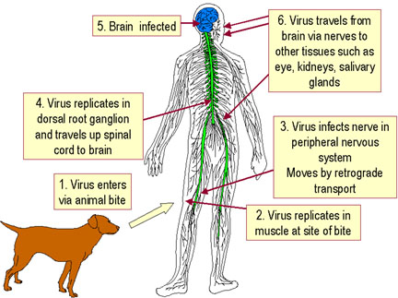

Slide 23
Spread of Virus
From Brain virus spread to
Salivary glands,
Conjunctival cell released into tears
Kidney
Lactating glands and Milk after pregnancy

Slide 24
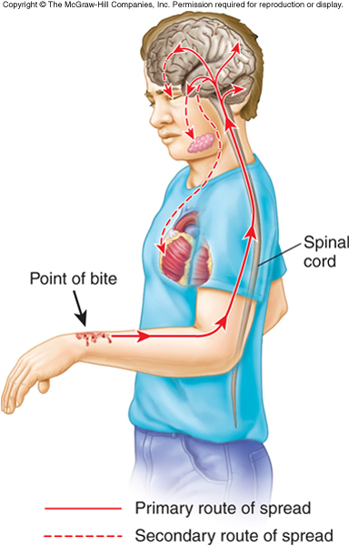
Pathologic pictures of Rabies
24
Notes:
24

Slide 25
Pathogenesis
Virus travels through axoplasam toward the spinal cord, at the rate of 3 mm/hour,
Towards the brain
Spread from brain centrifugally to various parts of the body.
Multiplies in the salivary glands and shed in the saliva.
Cornea, facial tissues skin.

Slide 26
Pathogenesis
Incubation 1 – 3 months.
May be average from 7 days to 3 years.
Stages of the disease.
Prodrome
Acute encephalitis.
Coma / Death.

Slide 27
Category as per WHO
Category I: touching or feeding suspect animals, but skin is intact
Category II: minor scratches without bleeding from contact, or licks on broken skin
Category III: one or more bites, scratches, licks on broken skin, or other contact that breaks the skin; or exposure to bats

Slide 28
Clinical Findings
Bizarre behavior.
Agitation
Seizures.
Difficulty in drinking.
Patients will be able to eat solids
Afraid of water - Hydrophobia.
Even sight of sound disturbs the patient.
But suffer with intense thirst.
Spasms of Pharynx produces choking
Death in 1 -6 days.
Respiratory arrest / Death / Some may survive.

Slide 29
Symptoms
Headache, fever, sore throat
Nervousness, confusion
Pain or tingling at the site of the bite
Hallucinations
Seeing things that are not really there
Hydrophobia
“Fear of water" due to spasms in the throat
Paralysis
Unable to move parts of the body
Coma and death
Notes:
29
Symptoms of rabies virus infection
The “incubation period” of rabies can vary from person to person (This is the time between exposure and actually getting symptoms). It may take several weeks to months after an exposure, before people become sick with rabies.
The symptoms can include:
The symptoms start with a headache, fever, and sore throat.
Nervousness and confusion develops.
The patient may experience pain or tingling at the site of the bite.
Many patients have hallucinations which means they see things that are not really there.
Case report: One parent of a patient said the patient was, “Cowering in the corner like a caged animal.”
Hydrophobia is also a symptom. Hydrophobia, or the fear of water, is due to spasms in the throat.
Case report: One patient said, “I throw up every time I try to eat or drink something. I can’t swallow my spit”
Paralysis or the inability to move parts of the body will develop later in the infection.
Eventually, the patient experiences a coma and ultimately death.

Slide 30
CLINICAL MANIFESTATIONS
1 – Non specific prodrome
2 – Acute neurologic encephalitis
Acute encephalitis
Profound dysfunction of brainstem
3 – Coma
4 - Death ( Rare cases → recovery )

Slide 31
CLINICAL MANIFESTATIONS
1 – Non specific prodrome
1 - 2 days → 1 week
Fever, headache, sore throat
Anorexia, nausea, vomiting,
Agitation, depression
Parenthesis or fasciculation's at or
Around the site of inoculation of virus.

Slide 32
Acute Neurologic Encephalitis
1 – 2 days to < 1 week
Excessive motor activity, Excitation, Agitation
Confusion, Hallucinations, Delirium,
Bizarre aberrations of thought, Seizures,
Muscle spasms, Meningismus,
Opisthotonic posturing
Mental aberration ( Lucid period → coma )
Hypersalivation, Aphasia, Pharyngeal spasms
Incordination, Hyperactivity

Slide 33
Acute Neurologic Encephalitis Phase
Fever T > 40.6
Dilated irregular pupils
Lacrimation, Salivation & Perspiration
Upper motor neuron paralysis
Deep tendon reflexes
Extensor plantar responses ( as a rule )
Hydrophobia or Aerophobia (50 -70% )

Slide 34
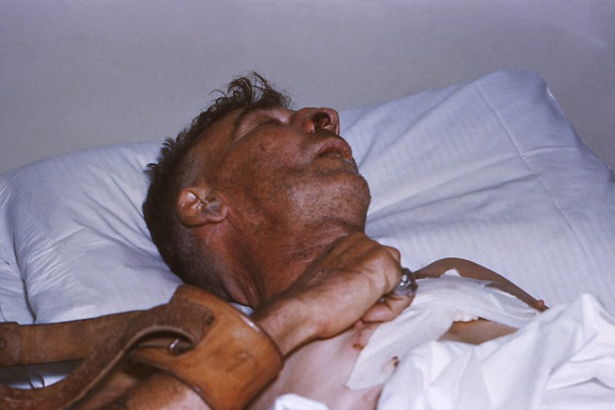

Slide 35
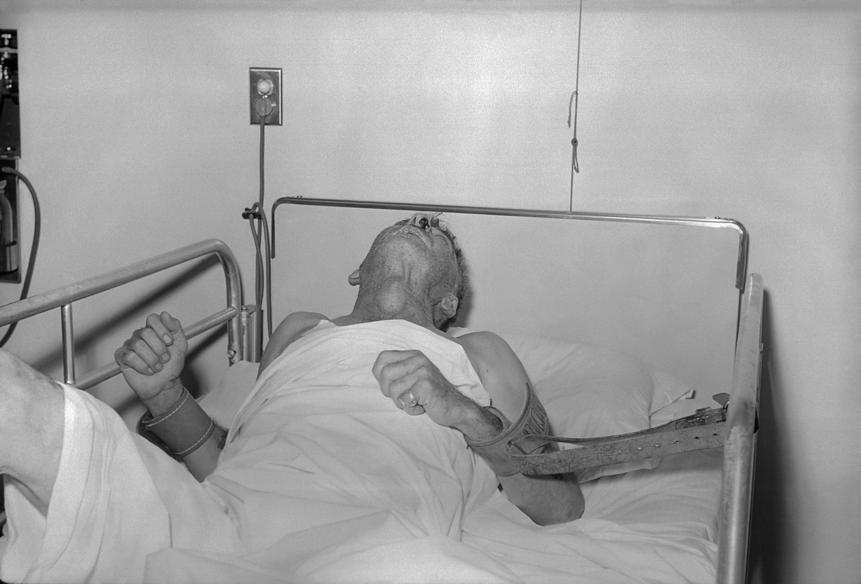

Slide 36
Diagnosis of Rabies
In most cases, human rabies is diagnosed primarily on the basis of clinical symptoms and signs, and a corroborative history of or evidence of an animal bite, death of an animal, and incomplete or no vaccination following exposure.2 The facility for laboratory diagnosis and confirmation of rabies, be it in humans or in animals, is available premortem in only a few institutions in India. T

Slide 37
Post mortem Diagnosis
The standard premortem test is a fluorescent antibody test to demonstrate the presence of viral antigen. The standard postmortem test is biopsy of the patient's brain and examination for Negri bodies. Autopsies are rarely performed.

Slide 38
DIAGNOSIS
Laboratory finding: ( CBC, CSF )
Exclusion of other etiologies
Pathology:
Formation of cytoplasmic inclusions:
( Negri bodies )
( Ammon’s horn, Cerebral cortex,
Brainstem, Hypothalamus,
The Purkinje cells of cerebellum,
Dorsal spinal ganglia )

Slide 39
Laboratory Diagnosis
Survival possible.
Clinical differentiation other cases of Encephalitis.
Post mortem Diagnosis by
By demonstration of Negri bodies.
Isolation of virus - Mice brain
inoculation.
tissue culture on culture lines
W 138, BHK,
PCR emerging method.
IF methods corneal impression method.

Slide 40
Diagnostic methods
Antigen detection by specific Immuno fluorescence.
Ante-mortem - Conjunctival,skin biopsy from nape of neck.
Postmortem impression from surfaces of salivary glands Hippocampus,
Histological examination
ELISA specific antibody detection.
PCR

Slide 41
DIFFERENTIAL DIAGNOSIS
Other viral encephalitis
Hysteria reaction to animal bite
Landry/Guillan-barre syndrome
Poliomyelitis
Allergic encephalomyelitis ( rabies vaccine )

Slide 42
PREVENTION
Preexposure Prophylaxis
Postexposure Prophylaxis

Slide 43
Ist Vaccine for Rabies
Prepared by Pasteur by drying various periods pieces of spinal cord of Rabbits infected with fixed virus
1885 Joseph Meister 9 year boy vaccinated 13 injections were given
Patient saved

Slide 44
Preexposure vaccination
Indicated in
Laboratory workers.
Veterinarians and technical staff.
Bat handlers.

Slide 45
Prophylaxis
Before exposure to infection
In Veterinary surgeons animal handlers.
Specific Prophylaxis
After exposure to Dog bite.
Local treatment
Cauterization,
Scrub with Soap and clean.
Use cetavalon, tincture of Iodine
Antirabic serum don't suture

Slide 46
Post exposure vaccination
Anti Rabies vaccines are given when person is
1 Bitten
2 Scratched
3 Licked
By Rabid animal
animal to be kept for 10 days ?

Slide 47
Vaccines
Semple vaccine
Contain 5 % suspension. Of infected Sheep brain, ( Infected with fixed virus )
Inactivated with Phenol at 37⁰c
Vaccines available after inactivation with Beta propiolactone Used in India
Vaccine contains Nucleic capsid antigen,
Small quantities of Glycoprotein G
Used in Developed countries Neural complications.

Slide 48
Category as per WHO
Category I: touching or feeding suspect animals, but skin is intact
Category II: minor scratches without bleeding from contact, or licks on broken skin
Category III: one or more bites, scratches, licks on broken skin, or other contact that breaks the skin; or exposure to bats

Slide 49
Neural Vaccines
Class I slight risk
Class II Moderate risk
Class III Great risk
Neural vaccines may cause Neuroparalytic complications, Laundry’s type ascending paralysis

Slide 50
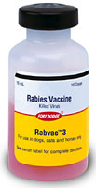
HUMAN RABIES Cell culture Vaccines
Vaccine:
Human diploid cell vaccine (HDCV)
Developed by Koprowsky,Wiktor,and Plotkin
Purified chick embryo cell vaccine (PCEC)
Purified Vero cell vaccine (PVRV)
Purified duck embryo vaccine (PDEV)

Slide 51
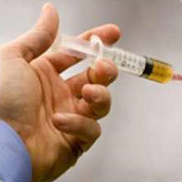
Preexposure prophylaxis doses
Given on the following days
0, 7, 21,or 28 and 56th day

Slide 52
Post exposure Prophylaxis
The vaccination is given on
0, 3, 7, 14, 30, and 90th day
Immunity lasts for 5 years
Injected on deltoid region IM/SC
Not to be given in the gluteal region

Slide 53
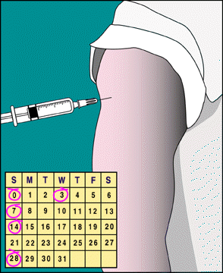
POSTEXPOSURE PROPHYLAXIS
– Active immunization

Slide 54
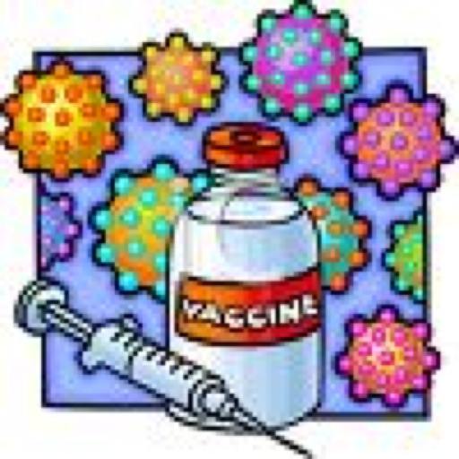
Cell culture Vaccines in India
1 Human diploid cell vaccine.
2 Purified chick embryo cell vaccine
3.Purified Vero cell vaccine

Slide 55
Human Diploid Cell Vaccine
Koprowsky, Viktor, Plokin
Inactivated in Betaproprionate.
No serious side effects.
Human Diploid cell vaccines purified .
Sub Unit vaccines in progress/developed.

Slide 56
Human Diploid Cell Vaccines
Dosage
Preexposure prophylaxis
0 – 7 – 21 – or 28 – 56 days
A booster after 1 year,
Repeat once in 5 days,
Post exposure Prophylaxis
Sex doses
0 -3 -7-14 – 30 - 90 days
Given IM or SC in the Deltoid region
Don't inject in Gluteal region.

Slide 57
Passive Immunization
Human Rabies Immunoglobulin HRIG
High Risk bitten on face and neck
Given a dose of 20 IU /Kg wt
Half at the site of bite and rest IM route.
Active immunization should be initiated with passive immunization.

Slide 58
POSTEXPOSURE PROPHYLAXIS
1 – Wound cleaning & treatment

Slide 59
If you are bitten or scratched
Tell an adult immediately
Wash the wound out with soap and water
Call your doctor right away

Slide 60
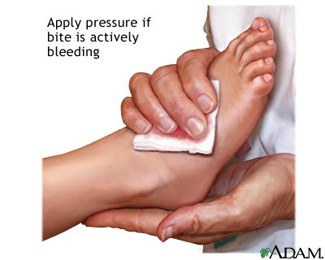

Slide 62
Epidemiology
No Danger of Nursing Rabies patients but do take precautions
Any animal bite can cause Rabies except Mice
BATS in caves in spread he disease by respiratory disease.
India around 30,000 die with Rabies.
Vaccination of the Dogs and Licensing of the Dogs

Slide 63
In spite of Health Education several die due to Rabies infection in Developing world

Slide 64
World's Rabies Day (on September 28
World Rabies Day is a cooperative global event planned to reduce the suffering from rabies. This day celebrates Dr. Louis Pasteur’s vision of a rabies free world.

