Slide 1
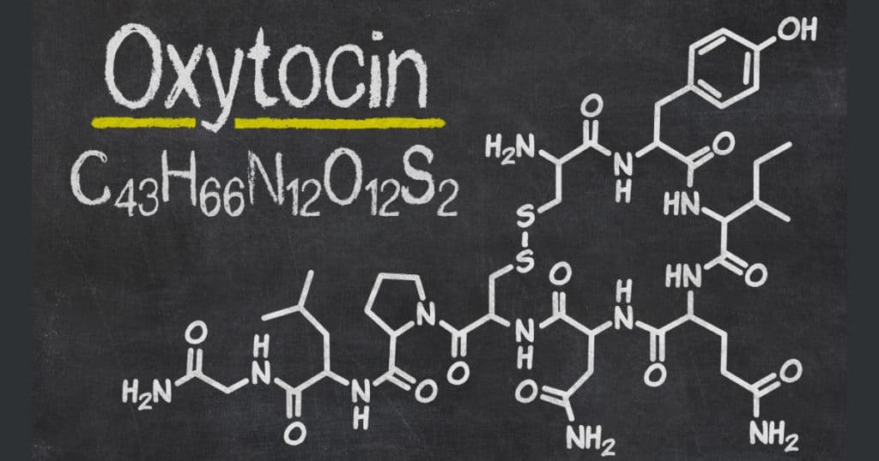
Oxytocin and Other Drugs Acting on Uterus
Dr. Meherunisa
Associate Professor
CIMS

Slide 2
Introduction
Drugs acting on uterus can primarily affect the endometrium or the myometrium.
The most important drugs affecting endometrium are estrogens, progestins and their antagonists.
Myometrium receives both sympathetic and parasympathetic innervation: autonomic drugs can affect its motility.

Slide 3
Anterior Pituitary
Posterior Pituitary
Anti Diuretic Hormone
Oxytocin
Product of Supraoptic nucleus
Product of Paraventricular nucleus
Both the hormones, they are synthesized in hypothalamus and then simply emptied into posterior capillaries from where these are drained into systemic circulation

Slide 5
Oxytocin
Derived from the term
Oxys= Quick
+
Tokos= Childbirth.
Oxytocin is a cyclic nonapeptide that differs from vasopressin by only two amino acids.
Its essential role is in milk ejection.
It also has a facilitatory role in initiation of labour and parturition.

Slide 6
Pharmacokinetics
T^{1/2} =5 minutes.
Not bound to plasma proteins.
Metabolzed in liver and excreted through kidneys.
2 mcg= 1IU of Oxytocin

Slide 7
Pharmacological Actions

Slide 8
Uterus- Estrogen sensitizes the uterus to oxytocin action while progesterone decreases.
Non pregnant uterus and early pregnancy uterus are resistant to oxytocin; sensitivity increases progressively in the third trimester; there is a sharp increase near term and quick fall during puerperium.
During abortion also uterus is very sensitive to oxytocin.

Slide 9
At the onset of labour oxytocin increases the magnitude as well as rate of contractions of the upper segment of the body of the uterus.
This further facilitates relaxation of cervix because due to the pressure from fetus head the lower segment of uterus and cervix are in process of relaxation.
Thus, oxytocin facilitates and co-ordinates the already existing uterine contractions.
Childbirth

Slide 10
Fetal head propagate reflexes
Which stimulates sensory nerves of the vagina send impulses to hypothalamus
Promotes release of oxytocin from the posterior pituitary.
Local prostaglandins also increase the oxytocin levels which increases uterine contractions during labour.

Slide 11
Breast - Oxytocin contracts the myoepithelium of mammary alveoli and forces milk into the bigger milk sinusoids—‘milk ejection reflex’ (milk letdown in cattle) is initiated by suckling so that it may be easily sucked by the infant.
CVS- Conventional doses used in obstetrics have no effect on BP, but higher doses cause vasodilatation → brief fall in BP, reflex tachycardia and flushing.
Kidney- Oxytocin in high doses exerts ADH-like action—urine output is decreased.

Slide 12
Physiological role
Labour- Oxytocin is released during labour and the uterus is highly sensitive to it at this time.
Milk ejection reflex- Suckling induces oxytocin release from pituitary which contracts the myoepithelial cells. These cells in breast are more sensitive than myometrium to oxytocin.
Neurotransmission- Oxytocin appears to function as a peptide neurotransmitter of oxytocinergic neurones in the hypothalamus and brainstem to regulate autonomic outflow.

Slide 13
Oxytocin receptors and antagonists
G protein coupled receptors
Generation of IP3 and subsequent mobilization of Ca2⁺ from intracellular stores
Depolarisation induced activation of voltage sensitive calcium channels.
Atosiban- oxytocin receptor antagonist- inhibits preterm labour. Given IV bolus followed by continuous IV infusion for not more than 24 hours.
S/E- nausea, vomiting, vasodilatation, hyperglycemia and rashes.

Slide 14
USEs
Induction of labour - Labour needs to be induced in case of postmaturity or prematurely in toxaemia of pregnancy, diabetic mother, erythroblastosis, ruptured membranes or placental insufficiency.
It is given by slow i.v. infusion: 5 IU is diluted in 500 ml of glucose or saline solution (10 milli IU/ml)— infusion is started at a low rate and progressively accelerated according to response (0.2–2.0 ml/ min).
Uterine contractions are then closely monitored.Usually a total of 2–4 IU is needed.
Notes:
Keep note-

Slide 15
Uterine inertia -When uterine contractions are feeble and labour is not progressing satisfactorily—oxytocin can be infused i.v. to augment contractions.
Oxytocin is the drug of choice and is preferred over ergometrine/PGs for the above two purposes:
(a) Because of its short t½ and slow i.v. infusion,
(b) Low concentrations allow normal relaxation in between contractions—foetal oxygenation does not suffer.
(c) Lower segment is not contracted: foetal descent is not compromised.
(d) Uterine contractions are consistently augmented.

Slide 16
Postpartum haemorrhage, Caesarean section- Oxytocin 5 IU may be injected i.m. or by i.v. infusion for an immediate response.
It acts by forcefully contracting the uterine muscle which compresses the blood vessels passing through its mesh work to arrest haemorrhage from the inner surface exposed by placental separation.
To promote milk ejection and Breast engorgement- Oxytocin is effective only in such cases; an intranasal spray (25-30 IU) may be given few minutes before suckling.

Slide 17
Oxytocin challenge test –
It is performed to determine uteroplacental adequacy in high risk pregnancies.
Oxytocin is infused i.v. at very low concentrations till uterine contractions are elicited every 3–4 mins.
A marked increase in foetal heart rate indicates uteroplacental inadequacy.
The test is risky and is rarely performed.

Slide 18
Desamino-oxytocin -It has been developed as a buccal formulation; action is similar to injected oxytocin, but less consistent.
Its indications are:
Induction of labour: 50 IU buccal tablet repeated every 30 min, max 10 tabs.
Uterine inertia: 25 IU every 30 min.
Promotion of uterine involution 25–50 IU 5 times daily for 7 days.
Breast engorgement 25–50 IU just before breast feeding.

Slide 19
Adverse effects
Injudicious use of oxytocin during labour can produce too strong uterine contractions forcing the presenting part through incompletely dilated birth canal, causing maternal and foetal soft tissue injury, rupture of uterus, foetal asphyxia and death.
Water intoxication: This occurs due to ADH like action of large doses given along with i.v. fluids, especially in toxaemia of pregnancy and renal insufficiency.

Slide 20
Contraindications
Presentation is not correct
Foetal lungs are immature
Cephalopelvic disproportion
Placenta previa
Foetal distress
Uterine scar (due to previous surgery).

Slide 21
Ergot Alkaloids
Only the amine ergot alkaloid ergometrine (ergonovine) and its derivative methylergometrine are used in obstetrics.

Slide 22
Actions
Uterus -They increase force, frequency and duration of uterine contractions.
At low doses, contractions are phasic with normal relaxation in between, but only moderate increase in dose raises the basal tone, contracture occurs with high doses.
The uterotonic action is believed to result from partial agonistic action on 5-HT2 and α adrenergic receptors.

Slide 23
CVS- Ergometrine and methylergometrine are much weaker vasoconstrictors than ergotamine and have low propensity to cause endothelial damage.
Though they can raise BP, this is not significant at doses used in obstetrics.
CNS- No overt effects occur at usual doses. However, high doses produce complex actions— partial agonistic/antagonistic interaction with adrenergic, serotonergic and dopaminergic receptors in the brain.
GIT- High doses can increase peristalsis

Slide 24
Pharmacokinetics
Rapidly and nearly completely absorbed from the oral route.
The onset of uterine action is: Oral—15 min; i.m.—5 min; i.v.—almost immediate.
They are partly metabolized in liver and excreted in urine.
Plasma t½ is 1–2 hours.
Effects of a single dose last 3–4 hours.

Slide 25
Adverse effects
Nausea
Vomiting
Rise in BP occur occasionally.
They can decrease milk secretion if higher doses are used for many days postpartum; due to inhibition of prolactin release (dopaminergic action).

Slide 26
Avoided in :-
Vascular disease, hypertension, toxaemia.
Presence of sepsis—may cause gangrene.
Liver and kidney disease.
They are contraindicated during pregnancy and before 3rd stage of labour.

Slide 27
Therapeutic uses
Management of third stage of labour- Ergometrine (0.2-0.5mg) is injected IM, after the appearance of anterior shoulder of of fetus.
To control and prevent postpartum haemorrhage (PPH): 0.2–0.3 mg i.m. at delivery of anterior shoulder reduces blood loss attending delivery and prevents PPH.

Slide 28
After caesarean section/instrumental delivery —to prevent uterine atony.
To ensure normal involution: A firm and active uterus involutes rapidly. To ensure this: 0.125 mg of ergometrine or methylergometrine has been given TDS orally for 7 days.

Slide 29
PROSTAGLANDINS
PGE2, PGF2α and 15-methyl PGF2α are potent uterine stimulants, especially in the later part of pregnancy and cause ripening of cervix.

Slide 30
UTERINE RELAXANTS
(Tocolytics)

Slide 31
These are drugs which decrease uterine motility.
They have been used to delay or postpone labour, arrest threatened abortion and in dysmenorrhoea.
Suppression of premature labour may be needed to allow the foetus to mature, to allow time for initiating glucocorticoid therapy for foetal lung maturation or to transfer the mother in labour to a centre with proper facilities.

Slide 32
Adrenergic agonists
Ritodrine, the β2 selective agonist having more prominent uterine relaxant action is approved to suppress premature labour and to delay delivery.
Myometrium
Decreases intracellular calcium levels

Slide 33
It is started as 50 µg/min i.v. infusion, the rate is increased every 10 min till uterine contractions cease or maternal HR rises to 120/min.
Contractions are kept suppressed by continuing i.v. infusion or by 10 mg i.m. QID followed by 10 mg oral 4–6 hourly.
Side effects
Cardiovascular -hypotension, tachycardia, arrhythmia, pulmonary edema
Metabolic -hyperglycaemia, hyperinsulinaemia, hypokalaemia
anxiety, restlessness, headache occur frequently.

Slide 34
Calcium channel blockers
Acts by impairing the calcium entry into myometrial cells via voltage dependant L-type channels to inhibit uterine contractility.
Oral nifedipine 10 mg repeated once or twice after 20–30 min, followed by 10 mg 6 hourly has been used.
Tachycardia and hypotension are prominent at doses which suppress uterine contractions.

Slide 35
Magnesium sulfate
Infused i.v. it is a first line drug for prevention and treatment of seizures in preeclampsia and eclampsia.
It also acts as a tocolytic by competing with Ca2+ ions for entry into myometrium through both voltage sensitive as well as ligand gated Ca2+ channels.
Preferred over beta2 agonists in patients having cardiac problems, diabetes, hypertension and hyperthyroidism.

Slide 36
Oxytocin antagonist- Atosiban
Miscellaneous drugs Ethyl alcohol, nitrates, progesterone, general anaesthetics and indomethacin (PG synthesis inhibitors) are the other drugs, which can depress uterine contractions.
However, their effect is not dependable and they are not used clinically as tocolytics.

