Slide 1
Bordetella, & Brucella
Dr. Amita Arya
Asst. Professor: Microbiology.
CIMS&H

Slide 2
General Overview of Bordetella & Brucella
Extremely small
Aerobic nonfermenters
Gram-negative coccobacilli
True pathogens: isolation always associated with disease; i.e., always clinically significant.

Slide 3
Human Disease & Associated Pathogens
Genus | Species | Disease
Bordetella | pertussis parapertussis bronchiseptica | Pertussis Pertussis (milder form) Bronchopulmonary disease
Brucella | melintensis abortus suis canis | Brucellosis Brucellosis Brucellosis Brucellosis

Slide 4
Bordetella pertussis

Slide 5
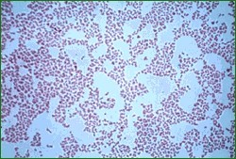
Bordetella pertussis Basics
Aerobic, Gram negative coccobacillus
Alcaligenaceae Family
Specific to Humans
Colonizes the respiratory tract
  Whooping Cough (Pertussis)
http://microvet.arizona.edu/Courses/MIC420/lecture_notes/bordetella_pertussis/ gram_pertussis.html

Slide 6
Epidemiology of
Bordetella pertussis Infection
Man is only natural host; obligate parasites of man
Disease is highly communicable (highly infectious)
Person-to-person spread via inhalation of
infectious aerosols
Incidence in U.S.A. significantly reduced with required DPT vaccine; Incidence increasing as some local school boards stop requirement
Children under one year at highest risk, but prevalence increasing in older children and adults

Slide 7
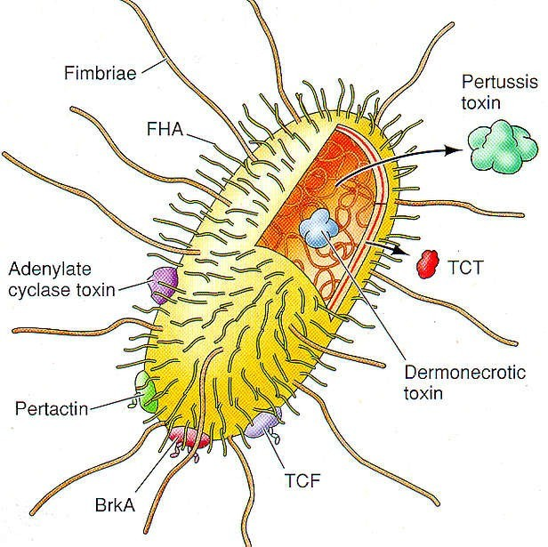
Bordetella pertussis
Gram-negative bacterium
Must attach to host cells to survive
Virulence factors damage host tissue
Contains LPS with unusual structure

Slide 8
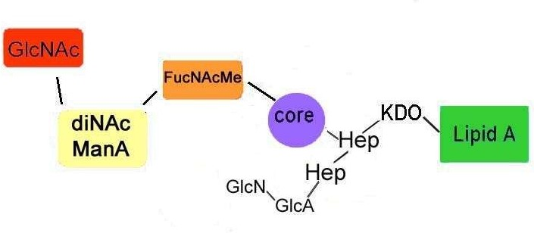
Lipopolysaccharide
Normal LPS contains three components:
  O-Antigen
  Core Polysaccharide
  Lipid A
Pertussis LPS lacks a highly polymerized O-side chain
Contains unusual sugars

Slide 9
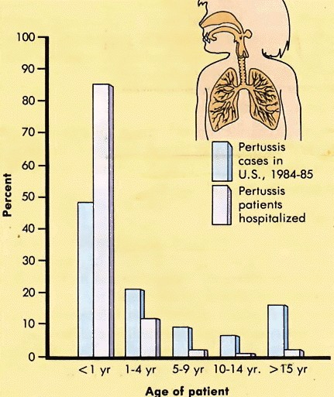
Age Distribution & Severity of Pertussis Cases

Slide 10
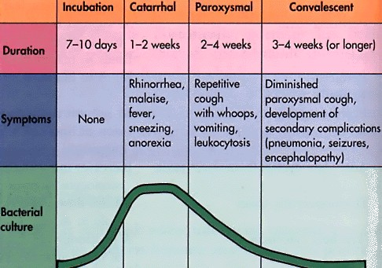
Clinical Progression of Pertussis
,
Inflammation of
respiratory mucosal memb.
or death
Most infectious, but generally not yet diagnosed

Slide 11
Virulence Factors Associated with Bordetella pertussis
Fimbriae not primarily involved in adherence; Exotoxin & hemagglutinin mediate attachment specifically to ciliated epithelium of bronchial tree
Cells multiply among cilia of epithelial cells and produce filamentous hemaglutinin and classic A-B exotoxin and other toxins leading to localized tissue
damage and systemic toxicity
  Pertussis toxin, adenylate cyclase toxin, tracheal cytotoxin, dermonecrotic toxin, filamentous hemagglutinin, LPS (lipid A & lipid X)
Classical A-B exotoxin has three distinct activities
  Histamine sensitizing factor
  Lymphocytosis promoting factor
  Islet activating protein

Slide 12
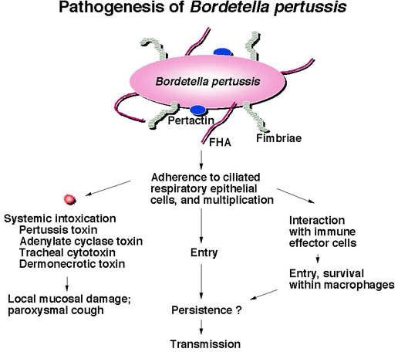
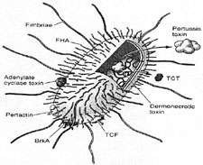
Adhesions
Filamentous hemagglutinin
Pertactin
Fimbriae
http://www.rivm.nl/infectieziektenbulletin/bul1306/kinkhoest.jpg
http://www.my-pharm.ac.jp/~yishibas/research/Pertussis1.jpg

Slide 13
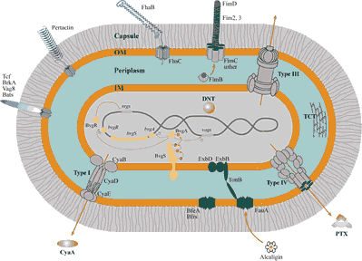
Toxins
Pertussis Toxin
Adenylate Cyclase Toxin
Tracheal cytotoxin
Dermonecrotic toxin
Heat-labile toxin
www.ibl.fr/u447/u447.htm

Slide 14
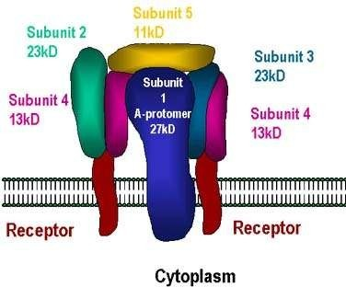
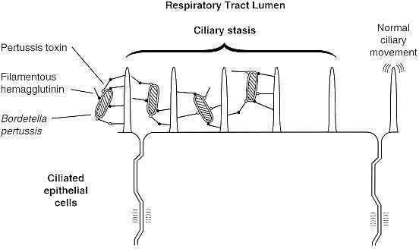
Pertussis Toxin
Colonizing factor and endotoxin
Cell bound and extracellular
gsbs.utmb.edu/ microbook/ch031.htm
www.med.sc.edu:85/ ghaffar/pertussis.jpg

Slide 15
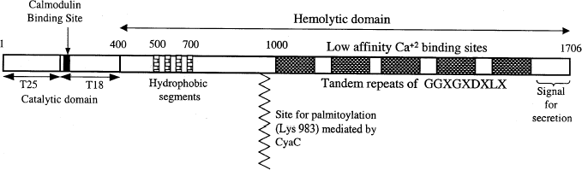
Adenylate Cyclase Toxin
Invasive toxin
Activated by host cell calmodulin
Impairment of immune effector cells
Babu et al., 2001

Slide 16
Laboratory Culture, Prevention & Treatment of Bordetella
Nonmotile
Fastidious and slow-growing
  Requires nicotinamide and charcoal, starch, blood, or albumin to absorb toxic substances
  Requires prolonged growth
  Isolated on modified Bordet-Gengou agar
Inactivated whole bacterial cells and toxoid are prepared in formalin for inclusion in DPT vaccine
Subunit (acellular) vaccine also available
Treatment with erythromycin, suction, oxygen
Treatment does not eliminate symptoms

Slide 17
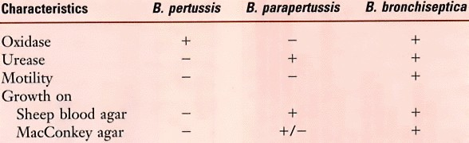
Differential Characteristics of Bordetella Species

Slide 18
Pertussis Laboratory Confirmation
Isolation of Bordetella pertussis from a clinical specimen
Positive polymerase chain reaction assay (PCR)
Direct fluorescent antibody (DFA) testing should NOT be used (low sensitivity and variable specificity)

Slide 19
Bordetella pertussis Culture
Cultures most often positive if the nasopharyngeal swab is obtained within the first week of cough onset
Beyond the first 3 weeks of illness the organism is recovered less often

Slide 20
PCR Testing
Widely available
Rapid, sensitive, and specific
Some PCR assays have not been completely reliable
Cultures should continue to be performed even if PCR tests are use

Slide 21
Brucella spp.

Slide 22
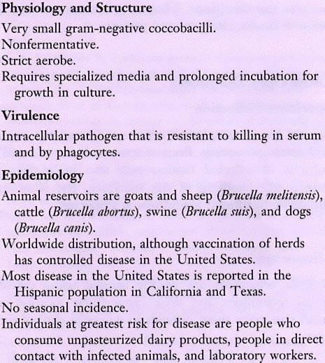
Brucella Infections

Slide 23
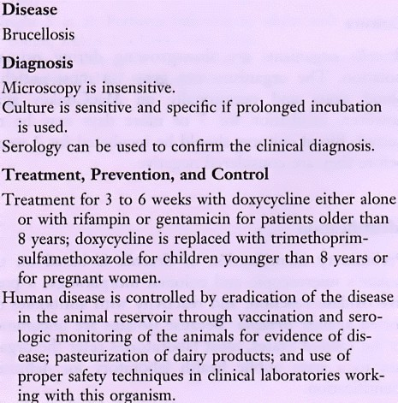
Brucella Infections
(cont.)

Slide 24
Epidemiology of Brucellosis
Animals are natural reservoir
  Cattle, goats, sheep, swine, bison, elk, dogs, foxes, coyotes
500,000 human cases per year worldwide
Less than 100 annual cases in the U.S. due to successful control of the disease in livestock and the animal reservoir
Transmission via i) ingestion of contaminated milk or cheese, or ii) direct contact with infected animals or animal products
Because it can be transmitted to humans, brucellosis is one of the most regulated diseases of cattle in the U.S.

Slide 25
Brucellosis in Animals
Brucella infect organs rich in erythritol (a sugar metabolized in preference to glucose) like breast, uterus, placenta and epididymis (tube that connects a pair of ducts that conduct spermatozoa during ejaculation)
Asymptomatic carriage, sterility or abortions
Transmitted between animals in aborted tissues

Slide 26
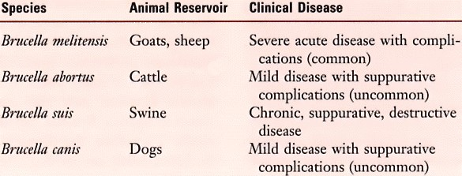
Human Brucellosis & Associated Species
Severe

Slide 27
Brucellosis in Humans
Reportable disease
Human brucellosis = Bang's disease, named for Bernhard Bang & Sir David Bruce who discovered Brucella
Facultative intracellular pathogens of mononuclear- phagocyte system (formerly reticuloendothelial system which is involved in immune defense against microbial infection and removal of worn-out blood cells)
  Bacteria are phagocytosed by macrophage or polymorphonuclear leukocyte
  Survive intracellularly by inhibiting killing
  Carried to spleen, liver, bone marrow, lymph nodes, kidneys
Form granulomas (mass of granulation tissue produced in response to chronic infections, inflammation, or foreign bodies) and cause destructive tissue damage

Slide 28
Brucellosis in Humans (cont.)
Consumption of contaminated unpasteurized milk or direct contact with infected animal reservoir
Disease associated with contact with infected cattle, cattle products, or dogs is a milder form
Disease associated with contact with goats and sheep is acute and severe with complications common
Disease associated with contact with swine is chronic & suppurative with destructive lesions and localization in cells of the reticuloendothelial system (RES)
•
•
Occupational hazard of laboratory personnel, veterinarians, farm workers, and meat handlers at risk through direct contact or inhalation
Protective clothing for abattoir workers, avoidance of unpasteurized dairy products
Highest numbers of cases reported in CA and TX

Slide 29
Clinical Presentation of Human Brucellosis
Acute disease often develops with initial nonspecific symptoms of malaise, chills, fatigue, weakness, myalgias (muscles), weight loss, arthralgias (joint), and nonproductive cough
Mild disease with rare suppurative complications
Chronic disease and recurrence are common because it can survive in phagocytic cells and multiply to high concentrations
May also take the form of destructive lesions

