Slide 1


Dr. AMITA ARYA
Assistant Professor (Dept. of Microbiology),
CIMS&H Lucknow.

Slide 2

Contents
GENUS
MORPHOLOGY
EPIDEMIOLOGY
TYPES
CLINICAL FEATURE
LAB DIAGNOSIS
TREATMENT
PREVENTION

Slide 3

* Tribe Yersinieae comprises Genus Yersinia
3 well established pathogens
*Yersinia pestis - Plague
*Yersinia pseudotuberculosis - Yersiniosis
*Yersinia enterocolitica - Yersiniosis
*

Slide 4


*Isolated by Alexander Yersin – 1894 – Hong Kong
*Causes Plague – systemic zoonosis – arthropod vector – rat flea
*GN oval coccobacillus
*Bipolar staining and pleomorphism
*Non motile, capsulated
*

Slide 5
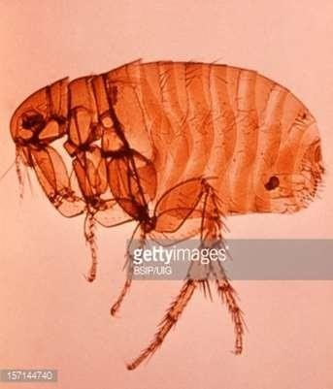
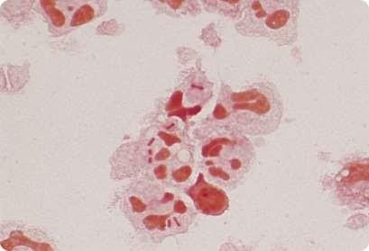
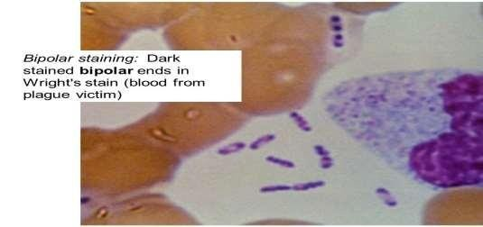

Slide 6
Plague pandemics
  1st – AD 541 – Roman Emperor Justinian
  2nd – 14th century – killed 1/3 of Europe
  3rd – 1894 - HongKong
Timeline of plague in India
  1896 – 1918 – HK pandemic entered India
  1918-1967 – declined, occasional cases
* 1967-1994 – no cases
  1994 (Surat, Guj) – pneumonic plague
  2002 – Shimla
  2004 – Uttarkashi, Uttaranchal
*

Slide 7
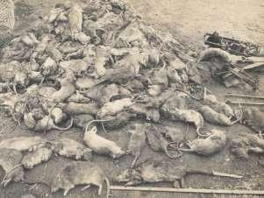
Reservoir – Wild rodents
Source of infection – infected wild rodents, rat fleas and cases of
pneumonic plague
Vector – Rat flea (Xenopsylla cheopis)
Plague cycles-
  Domestic cycle
  Wild or sylvatic cycle
Mode of transmission –
  Bite of infected rat flea
  Direct contact with tissues of infected rod
  Droplet inhalation – from cases
Blocked flea
Cheopis index
ent
* Seasonality – North India – (Sept – May), South – all year
*

Slide 8



*Fraction1 F1 antigen
*Phospholipase D
*Surface proteases
*pH 6 antigen
*LPS
*Pigmentation
*Low calcium respond plasmid
*Siderophore
*

Slide 9


Three Clinical Forms
*Bubonic plague (MC)
*Pneumonic plague
*Septicemic plague
*

Slide 10
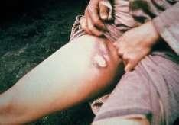



Transmitted – infected rat flea bite
Bacilli pass thru local lymphatics and reach local lymph nodes
IP is 2-7 days
C/F – sudden onset fever, malaise, headache, painful lymphadenitis
Buboes – regional LN tense, tender called buboes. MC –
inguinal, crural, axillary, etc
Bubonic plague – cannot spread
Complications – dissemination, pneumonia and meningitis
*

Slide 11

*Primary Pneumonic Plague – Inhalation Droplets
*IP – short, 1-3 days
*CF – suddent onset fever, headache, productive
cough, hemoptysis, dyspnea, chest pain
*Highly infectious and fatal
*Bioterrorism – aerosolised Y.pestis
*

Slide 12
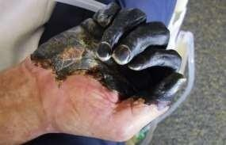

*Primary - Rare, accidental lab infections
*Secondary – due to spread of bubonic or pneumonic plague
*IP – 2-7 days
*Massive involvement of blood vessels – skin hemorrhages – gangrene – BLACK DEATH
*

Slide 13
*Specimen collection
Bubonic plague – pus, fluid aspirated from buboes
Pneumonic plague – sputum, blood
Septicemic plague – blood, splenic aspirate(PM)
*Transport medium – Cary-Blair
*Direct Microscopy –
Gram stain – PC and GN oval coccobacilli with
rounded ends, capsulated
Wayson stain / Meth blue- bipolar/safety pin
*

Slide 14
*Culture
*Aerobic, facultative anaerobic, non fastidious
*Optimum temp – 27 deg C, Capsule – 37deg C
*Blood agar – NH, dark brown pigmented
*Mac – NLF
*Nutrient broth – granular turbidity
*NB with oil or ghee – stalactites like growth
*CIN agar – Cefsulodin, Irgasan, Novobiocin – sputum sample

Slide 15
*Biochemicals
*Sugars – glucose, mannitol, maltose – acid, no gas
*Catalase positive, oxidase negative
*MR positive, VP negative
*Indole, Urease, Citrate – negative
*Animal inoculation
*Using 2 guinea pigs / white rats
*Molecular methods
*PCR

Slide 16

*Gentamicin – current recommendation
*Doxycycline and Chloramphenicol – also effective
*Beta lactams and macrolides – not recommended
*

Slide 17
Control of cases
Control of fleas – DDT, BHC
Control of rodents
Chemoprophylaxis – Doxy, tetracycline – DOC
Vaccine – only for prevention of anticipated outbreak
  Formalin killed vaccine – Sokhey’s modification of original Haffkine vaccine
    s/c, 2 doses, 4 weeks apart, booster> 6 months
    CI – infants<6 months
    Protection – 6 months
    No protection against – pneumonic plague
  Live attenuated vaccine – strain EV76
  Subunit recombinant F1 vaccine under trial
*

Slide 18

*Zoonotic infection –
*Y.enterocolitica, Y.pseudotuberculosis
*Pigs and other wild and domestic animals – host
*Human infection – raw pork, milk, etc
*Abdominal pain, ocassional diarrhea
*Y.enterocolitica – northern Europe, America
*Y.pseudotuberculosis - Finland
*

Slide 19
*Y.enterocolitica
Common virulence
f*actors
*Invasin
*Yersinia adhesin A
*Ail protein
*Myf antigen
*pH6 antigen
*Y.pseudotuberculosis
*Super antigen

Slide 20


*Self limited GE
*Intestinal complications – older children, pseudoappendicitis
*Septicemia – adults,
*Post infective phenomena
*Reactive arthritis
*Erythema nodosum
*Graves’ disease
*Super Ag – mitogen – Kawasaki’s disease
*

Slide 21

*Culture isolation
*From blood – BHI broth
*From LN aspirate – BA, MAC, NA
*From feces, food, soil – DCA, MAC, CIN Agar(dark red, bull’s eye colony)
*Incubation – at 25 deg C and 37 deg C
*Cold enrichment
*

Slide 22
*Biochemical tests
*Differential motility – motile at 22degC (not at 37degC)
*Cold enrichment – growth improves at 4deg C
*Urease positive
*Sugar fermentation
Sucrose, cellobiose, sorbitol – Y.enterocolitica
Rhamnose, salicin, melibiose – Y.pseudotuberculosis
VP, Ornithine decarboxylase – only Y.enterocolitica

Slide 23
*Ab detection – agglutination, ELISA
*Treatment
*Serology
*Diarrhea, self limiting
*Fluoroquinolone
*3rd gen cephalosporin

Slide 24

*

Slide 25
*Harbour respiratory tracts of many animals
*Pasteurella multocida – MC organism in dog/cat bite wounds
*P.haemolytica and P.pneumotropica rarely infect humans
*P.aviseptica – chicken cholera bacillus
*

Slide 26
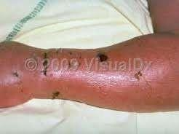
*Clinical findings
*Following animal bite – area – red, swollen, painful –
variable regional LN and low grade fever
*Pasteurella – commensal in human respiratory tract
*Infection following trauma / Sx leading to bacteremia
*Meningitis, appendicitis, Chronic respiratory
infection

Slide 27
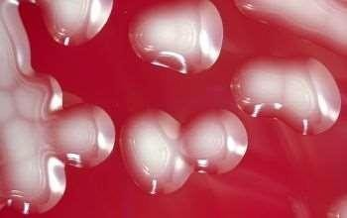

*Culture – aerobes or facultative anaerobes
*Direct Microscopy – non motile GNCB with a bipolar staining
Grow readily on ordinary media
Resemble Yersiniae but,
* Oxidase - positive
Indole – positive
MAC – No growth
*Treatment – Penicillin G for Pasteurella multocida
infections
*

Slide 28

*

Slide 29
*F.tularensis – causative agent of Tularemia – plague- like disease of rodents and other small animals
*Epidemiology
*Source – persists in contaminated environments,
insects, animal carriers
*Transmission –
Blood sucking insects- ticks
Contact with wild or domestic animals
Ingestion of contaminated water or food
Inhalation of infective aerosols
*

Slide 30

Four subspecies
*subsp.tularensis – most virulent, North
•A*merica

Slide 31
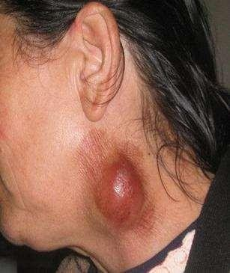


*Tularemia has various clinical syndromes
Ulceroglandular tularemia – MC form
Pulmonary tularemia – aerosol – Lab worker
Oropharyngeal tularemia – undercooked meat, membranous pharyngitis with cervical lymphadenopathy
Oculoglandular tularemia – purulent conjunctivitis
Typhoid-like illness
*Bioterrorism – Category A agent of bioterrorism
*

Slide 32

*Culture – highly fastidious
*BCG agar – Blood cysteine glucose agar
*CHAB agar – cysteine heart agar with 9% heated
sheep blood
*Sample – ulcer scraping, LN biopsy, gastric washing, sputum, blood – 37deg C – 2-4 days
*Colonies – blue gray, round, smooth, slightly mucoid
*BSL III - mandatory
*

Slide 33

*F.tularensis – small, GNCB, bipolar appearance, non motile, capsulated
*Weakly catalase positive, oxidase negative,
H2S positive
*Antibody detection – Agglutination tests and ELISA tests
*Molecular - PCR assay – specific genes encoding
*Treatment – Gentamic*in – DOC- 5mg/kg x 7-10 days
OMP

