Slide 1
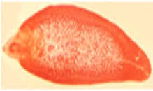
TREMATODES- I GENERAL FEATURES LIVER FLUKES INTESTINAL FLUKES
DR MONIKA RAJANI
ASSOCIATE PROFESSOR ,
DEPT OF MICROBIOLOGY
CIMSH , LKO

Slide 2
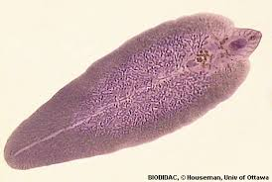
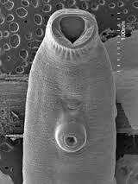
Introduction
Commonly known as flukes (flat fish)
Trematodes are unsegmented helminths
Leaf like, dorsoventrally flattened-flat and broad
The name trematode-”trema(hole)+eidos(appearance) due to presence of two prominent suckers with hole in middle.

Slide 3
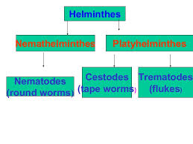
Classification

Slide 4
Systemic classification:
Phylum:Platyhelminthes
:Class:Trematoda
:Sub class:Digenea
:Order:Prostomata
Superfamily:Schistomatoidea
:Fascioloidea
:Opisthorchoidea
:Troglotrematoidea

Slide 5
Classification based on habitat- viva
Blood flukes: Schistosoma haematobium(vesical and pelvic venous plexus)
:Schistosoma mansoni(inferior mesentric vein)
:Schistosoma japonicum(superior mesentric vein)
Liver flukes: Clonorchis sinensis
: Fasciola hepatica
: Opisthorchis spp
Intestinal flukes:
:Small intestine:Fasciolopsis buski
:Hetrophyes heterophyes
:Large intestine:Gastrodiscoides homonis
Lung fluke: Paragonimus westermani

Slide 6
GENERAL FEATURES
Dorsoventrally flattened,
unsegmented,leaf like body
Two muscular cup shaped suckers-organs of attatchment
Oral sucker:surrounds mouth at anterior end
Ventral sucker(acetabulum): present ventrally in middle.
Body covered with integument bearing spines or papillae.
No body cavity
Circulatory and respiratory system absent

Slide 7
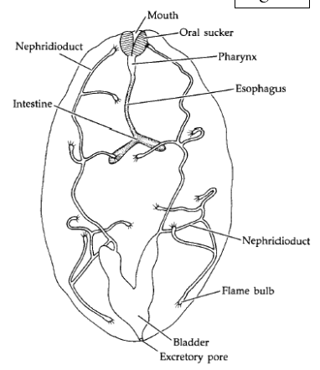
Mouth surrounded by oral sucker,pharynx and an oesophagus that bifurcates into two blind intestinal caeca to give inverted “Y ” shape to system
Alimentary system is incomplete as anus is absent.
Excretory system

Slide 8
Reproductive system
Reproductive system is well developed
Flukes are monoecious(hermaphrodites) except Schistosomes which are dioecious(sexes separate)

Slide 9
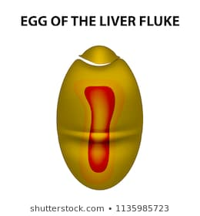
Eggs
Oviparous
operculated eggs(except in schistosomes).
Infective stage to man:
In schistosomes: cercaria
In others: metacercaria

Slide 10
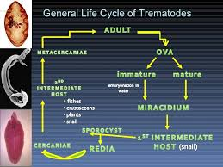

Slide 11
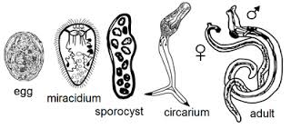
Stages during life cycle

Slide 12
MOI to definitive host
Cercaria leave snail and become free living in water
Cercaria infect definitive host by:
:Skin penetration-schistosomes
By converting into metacercaria :
which are taken in along with
- vegetables –Fasciola hepatica ,F buski
- Fish -Clonorchis sinensis
-Crab -P westermani

Slide 13
Liver flukes (Liver and Biliary tract)
Hermaphroditic flukes

Slide 14
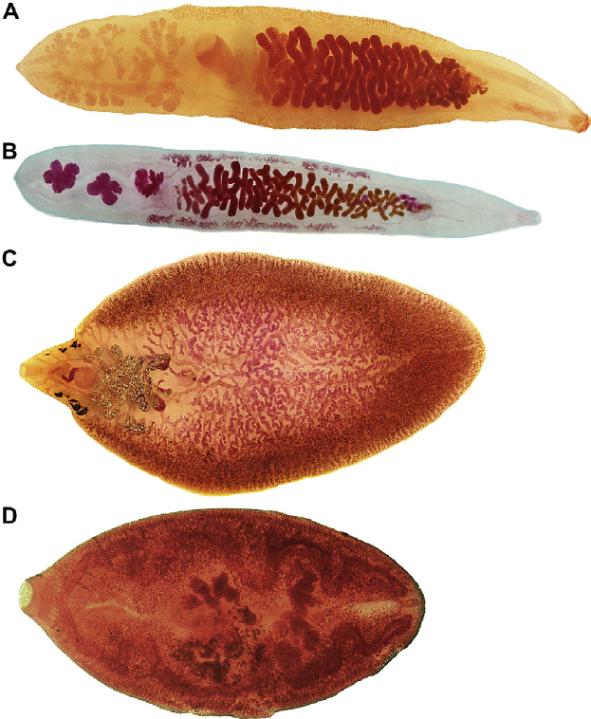
Members
Fasciola Hepatica : Sheep Liver fluke
Clonorchis sinensis: Chinese liver fluke
Opisthorchis spp

Slide 15
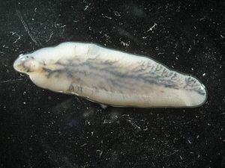
Fasciola hepatica
Sheep liver fluke

Slide 16
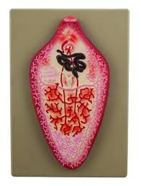
Introduction
First trematode to be discovered
Largest and commonest liver fluke
Primary host is sheep
Liver rot in sheep
Resides in liver and biliary tract

Slide 17
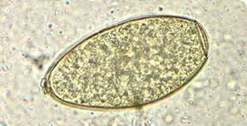
Morphology
adult
Eggs
Large,ovoid,operculated,
bile stained
Contain miracidium

Slide 18
Life cycle
Definitive host: sheep,goat cattle ,man
Intermediate host:
1 st intermediate host: fresh water snail(LYMNAEA)
2 nd intermediate host: aquatic plants
MOI: Ingestion of metacercariae in aquatic vegetation
SOL: biliary passages

Slide 19
Life cycle
Miracidium-sporocyst-redia-cercaria

Slide 20
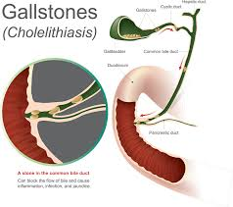
Pathogenicity
Fascioliasis
Acute:fever,right upper quadrant pain
Hepatomegaly
Chronic: biliary obstruction,cholangitis
Obstructive jaundice
Cirrhosis and PHT
Cholelithiasis
Anemia

Slide 21
Halzoun

Slide 22
Lab diagnosis
Stool, aspirated bile
Demonstration of eggs
Eosinophilia
Serology-AB and antigen
Imaging :USG
ERCP

Slide 23
TREATMENT
Triclabendazole
PROPHYLAXIS
Health education
Proper disinfection of watercresses and other water vegetations before consumption

Slide 24
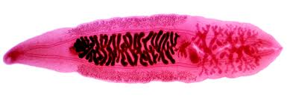
Clonorchis Sinensis
Chinese liver fluke
Oriental liver fluke
Japan,Korea, China, Vietnam
Adult worm: similar
Eggs: knob at bottom
Definitive host: humans
1st intermediate host: fresh water snail-Bulimus
2nd intermediate host: fish
Infective form: Metacercaria
MOI: Eating raw or unproperly processed fish, frozen , dried or pickled fish
CHOLANGIOCARCINOMA

Slide 27
Clinical features are same
Lab diagnosis similar
DOC:Praziquantel

Slide 28
INTESTINAL FLUKES
FASCIOLOPSIS BUSKI

Slide 29
Small intestine
Fasciolopsis buski
Large intestine
Gastrodiscoides hominis
Heterophyes
Metagonimus
Watsonius

Slide 30
Fasciolopsis buski
Giant intestinal fluke
Largest trematode infecting humans
Assam and Bengal
Habitat: duodenum or jejunum of pigs and man

Slide 32
Life cycle
Definitive host: man and pigs
First intermediate host : snails-segmentina genus
2nd intermediate host: aquatic plants,roots of lotus,bulb of water chestnut
Infective form: meta cercaria
MOI: consumption of aquatic plants
SOL:duodenum and jejunum

Slide 34
Clinical features
Inflammation
Local ulceration
Bowel obstruction
Malabsorption
Protein loosing enteropathy
Impaired B 12 absorption
Edema,ascites,anemia
Paralytic ileus

Slide 35
THANK YOU

