Slide 1
Miscellaneous bacteria
Dr Monika Rajani
Associate Professor,Microbiology
Career Institute of Medical Sciences and Hospital
Lucknow

Slide 2
List of Bacteria
Legionella pneumophila
Gardenella vaginalis
HACEK
Streptobacillus moniliformis
Spirillum minus
Klebsiella granulomatis

Slide 3
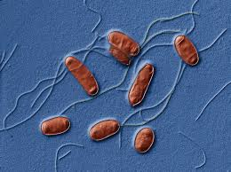
Legionella Pneumophila
Legionnaires ds:
new illness in 1976 in Philadelphia
Fever, cough and chest pain, pneumonia, fatal

Slide 4
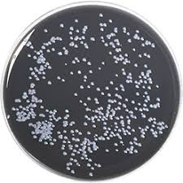
Legionella pneumophila
GNCB, motile with polar flagella
Best visualised by Silver impregnation methods
DFA staining
Culture :BCYE-Buffered charcoal yeast extract agar

Slide 5
Epidemiology
Widely distributed in natural water sources like stagnant waters ,mud and hot springs
Here Nutritional requirements are provided by algae in water sources
Can also survive and multiply in free living amoebae
Can amplify in artificial aquatic environments which serve as amplifiers

Slide 6
Mode of infection
Inhalation of aerosols from AC, cooling towers, shower heads acting as disseminators
Aerosolised legionellae carried to long distances and survive longer
No carrier state, no animal reservoir, no human to human transmission
RF: Smoking, alcohol, age

Slide 7
Mode of infection

Slide 8
Pathogenicity - Legionellosis
Causative organism: Legionella pneumophila
Presentation: Legionnairres disease and Pontaic fever
MOI: Inhalation of aerosols lead to entry in alveoli where they multiply within monocytes and macrophages
Being intracellular only CMI Is effective for recovery
Spread : occures by bloodstream, lymphatics

Slide 10
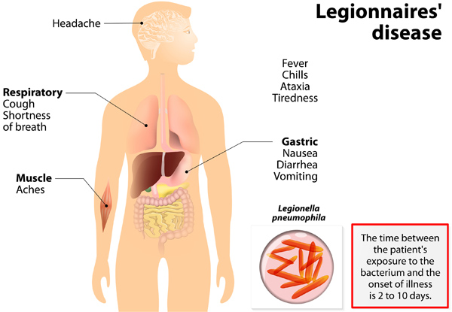
Clinical presentation-Legionnaires disease
Epidemic or sporadic
IP=2-10 DAYS
Fever ,cough, dyspnea
Pneumonia
Respiratory failure and shock

Slide 11
Clinical presentation-pontaic fever
Milder,non fatal,influenza life illness
Fever,chills,myalgia

Slide 12
Lab diagnosis
Sample:
sputum, bronchial aspirate, biopsy
Microscopy: DFA
Culture: BCYE media
Serology: Latex agglutination
–detection of Ag in urine
ELISA

Slide 14
SUMMARY

Slide 15
Gardnella vaginalis
Bacteria:
GNR, NM, pleomorphic
Disease: bacterial vaginosis

Slide 16
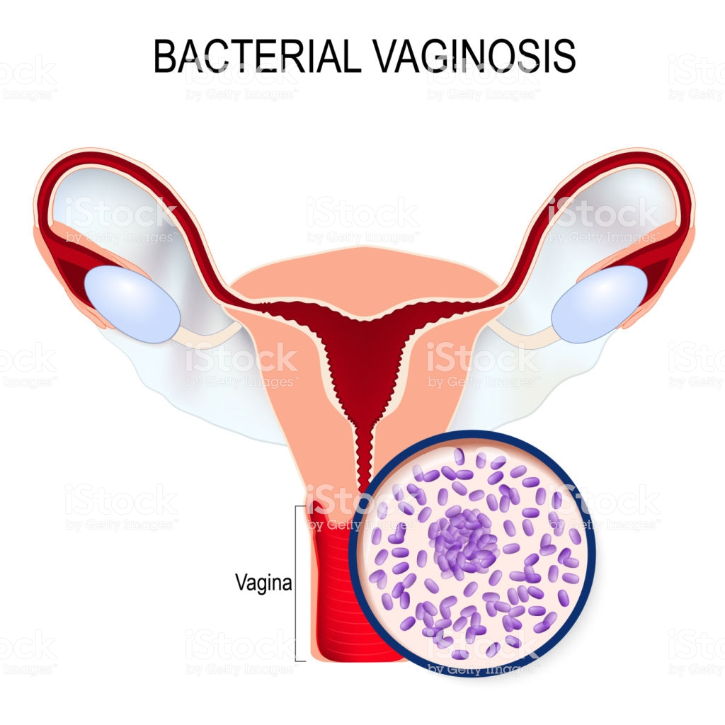
Disease: Bacterial vaginosis
Raised vaginal pH>4.5
fowl smelling discharge
Presence of clue cells
Nugents score
Metronidazole is DOC

Slide 17
Clue cells
Vaginal epithelial cells with their surface studded with numerous small bacteria.
Clue cells are also seen in infections by anaerobic bacteria called Mobilincus

Slide 18
Clue cells
Clue cells are single most reliable indicators of bacterial vaginosis

Slide 19
Nugents score
The diagnosis of bacterial vaginosis is made on microscopic criteria of gram smear of high vaginal swab using the Nugents score
A score of 7 to 10 is consistent with bacterial vaginosis without culture.

Slide 21
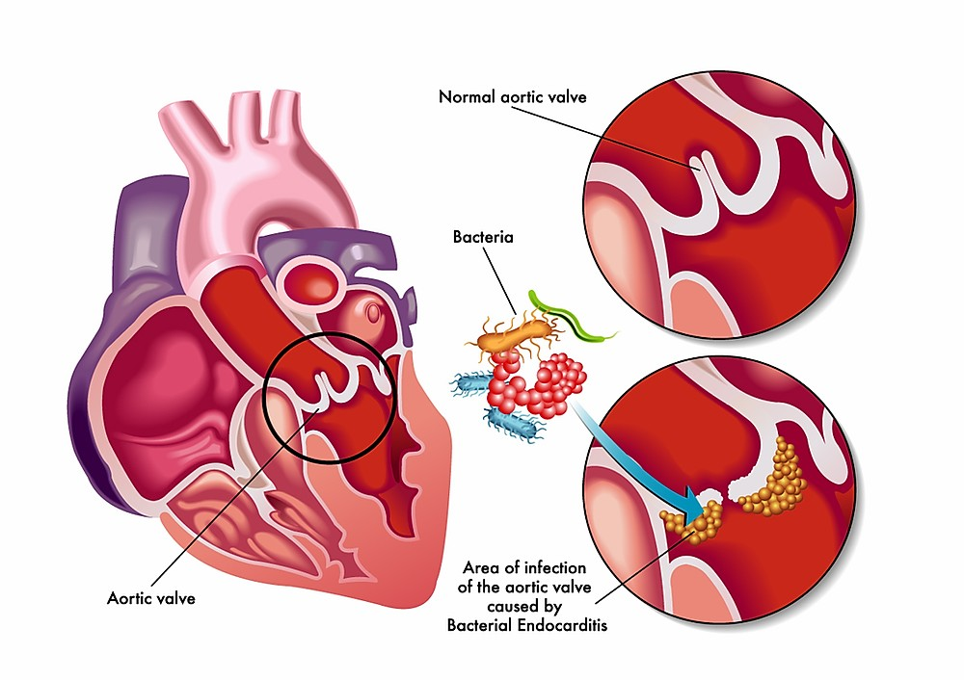
All HACEK members are fastidious Gram-negative bacteria associated with Infective Endocarditis

Slide 23
SPREAD
they spread hematogenously following introduction into the blood during tooth brushing, dental cleanings, or subsequent to oral diseases such as periodontitis.

Slide 24
Clinical Identification of HACEK organisms
Previously, HACEK organisms were implicated in endocarditis from which no pathogen could be isolated (so called “culture-negative endocarditis”)
This was attributed to slow growth in old formulations of blood culture bottles
On Extended incubation (>5 days) the presence of these organisms was suspected.
modern blood culture instruments reliably detect HACEK organisms within a 5-day incubation period.

Slide 25
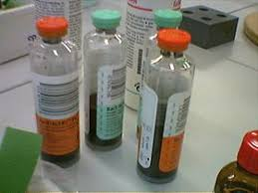
ISOLATION
automated blood culture systems (BACTEC) are better than manual culture
often growing better on chocolate agar than on blood agar.
MALDI-TOF is emerging as a potential identification technology for the HACEK group.

Slide 26
TREATMENT
PENICILLINS
CEPHALOSPORINS

Slide 27
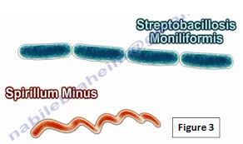
Streptobacillus moniliformis and Spirillum minus

Slide 28
Both these bacteria are natural parasites of rodents and cause RAT BITE FEVER

Slide 29
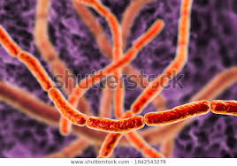
STREPTOBACILLUS MONILIFORMIS
Natural parasite of rodents
Disease : Rat Bite Fever(RBF)
Bacteria: GNR,pleomorphic
Grows as tangled chain of rods

Slide 30
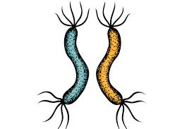
Amphitrichous flagella

Slide 31
Rat bite fever
MOI:
rat bite
Consumption of raw milk or water contaminated by rats

Slide 32
RAT BITE FEVER
First observed in Haverhill USA
HAVERHILL FEVER
Erythema arthriticum epidemicum

Slide 33
Clinical presentation
Abrupt onset 2-10 days after exposure
Fever ,headache,myalgia
Petechial rash
arthritis

Slide 34
LAB DIAGNOSIS
Microscopic examination of blood and exudates from lesion
Streptobacillus can be cultured on BA,CA
Spirillum isolated by intraperitoneal inoculation in mice
serology
Treatment
Oral penicillin
doxycycline

Slide 35
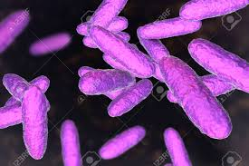
Klebsiella granulomatis
Formerly known as donovania granulomatis and Calymmatobacterium granulomatis
Disease: DONOVANOSIS or Granuloma inguinale

Slide 36
Donovanosis
Venereal disease
Painless papule on genitalia
Shaft of penis,labia or perinium involved
Leads to slowly progressive autoinoculable ulcer
Chronicity

Slide 37
Lab diagnosis
Safety pin appearance
Demonstration of Donovan bodies in Wright Giemsa stained impression smears from the lesions

Slide 38
Donovan Bodies
Rounded coccobacilli ,1-2 um in size within cystic spaces in large mononuclear cells
The coccobacilli appear as CLOSED SAFETY PIN APPEARANCE In stained smears due to BIPOLAR condensation of chromatin

Slide 39
Important questions
Short notes
Helicobacter
Antibiotic associated diarrhea
Legionella –atypical pneumonia
Oral/viva
Donovan bodies
Clue cells
rat bite fever
Urea breath test
Different motility and flagellar arrangement of bacteria

Slide 40
Thank you

