Slide 1
HAEMATINICS AND ERYTHROPOIETIN
By: Dr Darakhshan Rizvi
CIMS
Department of Pharmacology

Slide 2
OVERVIEW
Definition of haematinics
Sources of Iron
Distribution of iron
Iron metabolism & Elimination
Different iron preparations
Iron poisoning treatment
Erythropoietin

Slide 3
DEFINITION
These are substances required in blood formation are used as adjuvants in treatment of anaemia.
Anaemia occurs when the balance between production and destruction of RBCs is disturbed by:
(a) Blood loss (acute or chronic)
(b) Impaired red cell formation due to
• Deficiency of essential factors, i.e. iron, vitamin B12, folic acid.

Slide 4
DEFINITION
Bone marrow depression (hypoplastic anaemia), erythropoietin deficiency.
(c) Increased destruction of RBCs (haemolytic anaemia)

Slide 5
Distribution of iron in body
Iron is an essential body constituent.
Total body iron in an adult is 2.5–5 g (avg 3.5 g).
It is more in men (50 mg/kg) than in women (38 mg/kg).
It is distributed into:
Haemoglobin (Hb) : 66%
Iron stores as ferritin and haemosiderin : 25%
Myoglobin (in muscles) : 3%
Parenchymal iron (in enzymes, etc.) : 6%

Slide 6
Daily requirement
To make good average daily loss, iron requirements are:
Adult male : 0.5–1 mg (13 µg/kg)
Adult female (menstruating) : 1–2 mg (21 µg/kg)
Infants : 60 µg/kg
Children : 25 µg/kg
Pregnancy : 3–5 mg (80 µg/kg)

Slide 7
Dietary sources of iron
Rich: Liver, egg yolk, oyster, dry beans, dry fruits, wheat germ, yeast.
Medium: Meat, chicken, fish, spinach, banana, apple.
Poor: Milk and its products, root vegetables.

Slide 8
Iron absorption
The average daily diet contains 10–20 mg of iron.
Its absorption occurs all over the intestine, but majority in the upper part.
Dietary iron is present either as haeme or as inorganic iron.
Absorption of haeme iron is better (upto 35% compared to inorganic iron which averages 5%) and occurs directly without the aid of a carrier

Slide 9
Iron absorption
The major part of dietary iron is inorganic and in the ferric form.
It needs to be reduced to the ferrous form before absorption.

Slide 10
IRON ABSORPTION

Slide 11
Factors facilitating iron absorption
1. Acid: by favouring dissolution and reduction of ferric iron.
2. Reducing substances: ascorbic acid, amino acids containing SH radical. These agents reduce ferric iron and form absorbable complexes.
3. Meat: by increasing HCl secretion and providing haeme iron.

Slide 12
Factors impeding iron absorption
Alkalies (antacids) render iron insoluble, oppose its reduction.
Phosphates (rich in egg yolk)
Phytates (in maize, wheat)
Tetracyclines
Presence of other foods in the stomach.
In general, bioavailability of iron from cereal based diets is low.

Slide 13
Mucosal block
The gut has a mechanism to prevent entry of excess iron in the body.
Iron reaching inside mucosal cell is either transported to plasma or oxidised to ferric form and complexed with apoferritin to form ferritin.
This ferritin generally remains stored in the mucosal cells and is lost when they are shed (lifespan 2–4 days). This is called the ‘Ferritin curtain’.

Slide 14
Iron status of the body and erythropoietic activity govern the balance between these two processes, probably through a ‘haematopoietic transcription factor’, and thus the amount of iron that will enter the body.

Slide 15
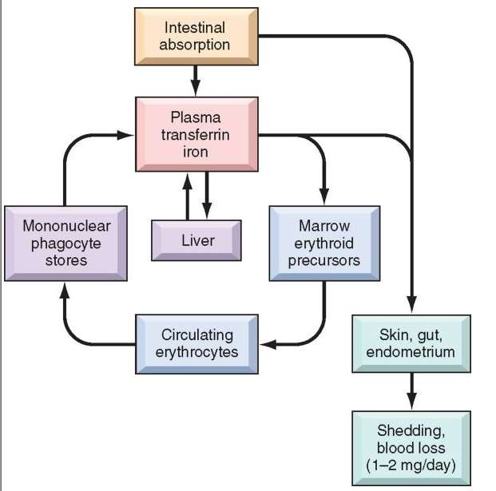
Iron metabolism
15

Slide 16
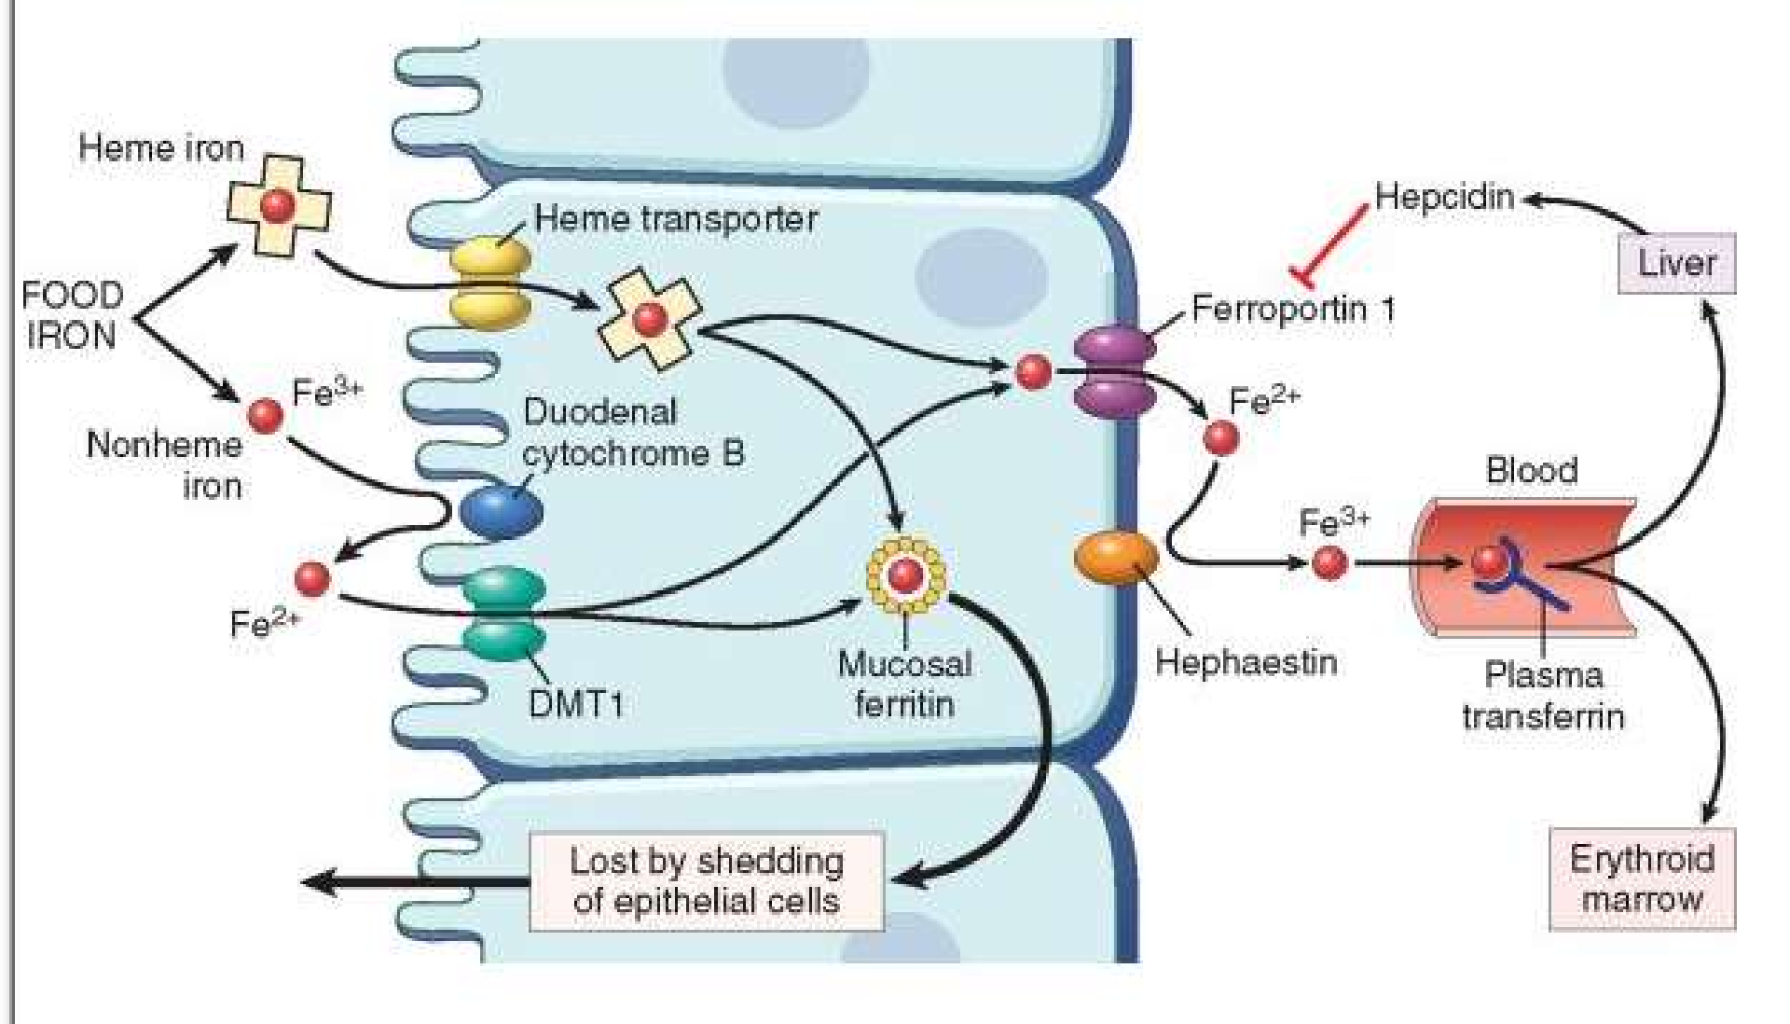
Transport of iron
16

Slide 17
Preparations and dose
Oral iron
The preferred route of iron administration is oral.
Dissociable ferrous salts are inexpensive, have high iron content and are better absorbed than ferric salts, especially at higher doses.
Gastric irritation and constipation are related to the total quantity of elemental iron administered.

Slide 18
ORAL IRON PREPARATIONS
Ferrous sulphate(32% iron): cheap, metallic taste is present 200mg tab
Ferrous gluconate (12% iron) 300mg,400mg/15ml elixer
Ferrous fumarate (33% iron) 200mg tab
Colloidal ferric hydroxide (50% iron) 50mg/ml drops
Carbonyl iron highly pure fine powder prepared by decomposition of iron pentacarbonyl ,toxic compound
Ferrous salts are cheap, high iron content, better absorbed than ferric
salts
All have same degree of gastric tolerance
18

Slide 19
For full haematopoietic effect –
Adult total dose of 200mg of elemental iron given daily in 2 or 3
divided doses in empty stomach.
Child- 3-5mg/kg in 3 divided doses
Prophylaxis:
30mg elemental iron/day is sufficient.

Slide 20
Adverse effects of oral iron
Epigastric pain
Heartburn
Nausea
Vomiting
Bloating
Staining of teeth
Metallic taste, colic, etc.
Tolerance to oral iron can be improved by initiating therapy at low dose and gradually escalating to the optimum dose.

Slide 21
Parenteral iron
Iron therapy by injection is indicated only when:
1. Oral iron is not tolerated: bowel upset is too much.
2. Failure to absorb oral iron: malabsorption inflammatory bowel disease.
Chronic inflammation decreases iron absorption, as well as the rate at which iron can be utilized

Slide 22
Parenteral iron
3. Non-compliance to oral iron.
4. In presence of severe deficiency with chronic bleeding.
5. Along with erythropoietin: oral iron may not be absorbed at sufficient rate to meet the demands of induced rapid erythropoiesis.
For replinishment of iron stores this formula is been used
Iron requirement (mg) = 4.4 × body weight (kg) × Hb deficit (g/dl)

Slide 23
Organic Preparations
Iron dextran & iron sorbitol - citric acid (i.m)
Ferrous sucrose & ferric carboxymaltose
Iron dextran: i.v/i.m
Colloidal preparation of ferric oxyhydroxide complexed with polymerized dextran.
High molecular weight >6000, dark brown viscous liquid.
50mg of elemental iron is present in one ml.Only preparation that can be injected i.m as well as i.v.

Slide 24
Iron dextran: i.v/i.m
By i.m. route it is absorbed through lymphatics, circulates without binding to transferrin and is engulfed by RE cells where iron dissociates and is made available to the erythron for haeme synthesis.
In the injected muscle 10–30% of the dose remains locally bound and becomes unavailable for utilization for several weeks.
Thus, 25% extra needs to be added to the calculated dose.
Iron-dextran is not excreted in urine or in bile.

Slide 25
i.m:
Given deep in gluteal region using Z track technique.
Iron dextran can be injected 2 ml daily, or on alternate days, or 5 ml each side on the same day.

Slide 26
On i.v administration
After test dose of 0.5 ml injected I.V over 5-10mins, 2ml injected/day by taking 10 mins for injection.
Alternatively total calculated dose is diluted in 500ml of glucose/saline solution infused i.v over 6-8 hrs under constant observation.
If any complaints of giddiness, paresthesia, chest tightness present should be terminated.
To avoid risk of hypersensitivity 0.25-0.5ml inj i.v over to ½-1hr reactions perform sensitivity test with small test dose before i.v/i.m.

Slide 27
ADVERSE DRUG REACTIONS
Local:
Pain at inj site, pigmentation, sterile abscess- old deblitated pts.
Systemic:
Fever, headache, joint pain, flushing, palpitation, chest pain,
dyspnoea, lymph node enlargement.
Rare:
Anaphylactoid reaction vascular collapse and death.

Slide 28
IRON SORBITOL CITRIC ACID COMPLEX:
It is a low molecular weight complex which can be injected only i.m., from where absorption occurs directly into circulation and not through lymphatics.
No local binding in muscle occurs, but about 30% of the dose is excreted in urine; the calculated total dose has to be increased accordingly.

Slide 29
IRON SORBITOL CITRIC ACID COMPLEX:
Patient may be alarmed because the urine turns brown after some time. Iron-sorbitol-citric acid binds to transferrin in plasma and may saturate it if present in large quantity.
That is why it is not suitable for i.v. injection or infusion, as the remaining free iron is highly toxic.
Even with the recommended i.m. dose, incidence of immediate reaction, including ventricular tachycardia, A-V block, other irregularities, hypotension, flushing is higher

Slide 30
Ferrous-sucrose
Newer formulation is a high molecular weight complex of iron hydroxide with sucrose, that on i.v. injection is taken up by RE cells, where iron dissociates and is utilized.
It is safer than the older formulations and a dose of 100 mg can be injected i.v. taking 5 min, once daily to once weekly till the total calculated dose is administered.
Solution is highly alkaline ruling out i.m./s.c. injection

Slide 31
The incidence of hypersensitivity reaction is very low.
This preparation is particularly indicated for anaemia in kidney disease patients, but reports of kidney damage are on record.
Oral iron should not be given concurrently and till 5 days after the last injection.
Notes:
,

Slide 32
Ferric carboxymaltose
It is the latest formulation of iron in which a ferric hydroxide core is stabilized by a carbohydrate shell.
The macromolecule is rapidly taken up by the RE cells, primarily in bone marrow (upto 80%), as well as in liver and spleen.
Iron is released and delivered subsequently to the target cells.
It is administered either as daily 100 mg i.v. injection, or upto 1000 mg is diluted with 100 ml saline (not glucose solution) and infused i.v. taking 15 min or more.

Slide 33
Ferric carboxymaltose
It should not be injected i.m.
The incidence of acute reaction is very low.
Pain at injection site, and rashes have occurred, but anaphylaxis is rare.
Headache, nausea, abdominal pain are generally mild. Hypotension, flushing and chest pain are infrequent.

Slide 34
Iron poisoning
In Infants and children 10-20 tab or equivalent liquid preparation (>60mg/kg iron) cause serious toxicity.
Manifestations are:
Vomiting
Abdominalpain
Haematemisis
Diarrhoea
Lethargy
Cyanosis
Dehydration
Acidosis,convulsion, shock, cardiovascular collapse and death.

Slide 35
Haemorrhage
Hepatic necrosis and brain damage present.
Treatment of poisoning Supportive measures
Fluid & electrolyte balance Vitals monitoring
Diazepam i.v – convulsions
To prevent further absorption of iron from gut:
Induce vomiting & gastric lavage with sodium bicarbonate solution to render iron insoluble.
Egg yolk and milk orally it causes complex of iron.Activated charcoal does not adsorb iron.

Slide 36
Bind and remove iron already absorbed:Desferrioxamine :
Iron chelator is D.O.C
Obtained from streptomyces pilosus potent and specific
Readily binds ferric iron to form ferrioxamine
Well tolerated
Rapid iv causes hypotension, tachycardia, anaphylactoid reaction & urticaria.

Slide 37
Bind and remove iron already absorbed:Desferrioxamine :
Dose: I.M 0.5-1g (50mg/kg) repeatedly 4-12hrs required or
I.V in case of shock 10-15mg/kg/hr, max 75mg/kg in a day till serum iron falls below 300µg/dl
Alternatively DTPA or calcium edetate can be used.
BAL is contraindicated because its iron chelate is also toxic.

Slide 38
Contraindication for treatment :
Severe renal disease
Pregnant women
Hemochromatosis:
Desferrioxamine useful in prevention and treatment of iron overload in chronic anemia in thalassemia major with multiple transfusions.
Given continuous infusion 2g for 12hrs OD,but phlebectomy is treatment of choice.
Deferiprone, Deferasirox are alternative choice for those who cannot tolerate the above drug.

Slide 39
VITAMIN-B12
Cyanocobalamin and hydroxocobalamin are complex cobalt containing compounds present in the diet and referred to as vit B12.
Vit B12 occurs as water soluble, thermostable red crystals. It is synthesized in nature only by microorganisms; plants and animals acquire it from them.

Slide 40
Dietary sources
Liver
Kidney
Sea fish, egg yolk, meat, cheese are the main vit B12 containing constituents of diet.
The only vegetable source is legumes (pulses) which get it from microorganisms harboured in their root nodules.
Daily requirement 1–3 µg, pregnancy and lactation 3–5 µg.

Slide 41
Metabolic functions
Vit B12 is essential for the conversion of homocysteine to methionine. This reaction is also critical in making tetrahydrofolic acid (THFA) available for reutilization.
Purine and pyrimidine synthesis is affected primarily due to defective ‘one carbon’ transfer because of ‘folate trap’.

Slide 42
Metabolic functions
Malonic acid converted to Succinic acid is an important step in propionic acid metabolism. It links the carbohydrate and lipid metabolisms.
Interference with the reaction: Methionine to S-adenosyl methionine may be more important in the neurological damage of B12 deficiency, because it is needed in the synthesis of phospholipids and myelin.

Slide 43
Metabolic functions
Vit B12 is essential for cell growth and multiplication.

Slide 44
Manifestations of deficiency
Megaloblastic anaemia (generally the first manifestation), neutrophils with hypersegmented nuclei, giant platelets.
Glossitis, g.i. disturbances: damage to epithelial structures.
Neurological: subacute combined degeneration of spinal cord; peripheral neuritis—diminished vibration and position sense, paresthesias.

Slide 45
ERYTHROPOIETIN
Erythropoietin (EPO) is a sialoglycoprotein hormone (MW 34000) produced by peritubular cells of the kidney that is essential for normal erythropoiesis.
Anaemia and hypoxia are sensed by kidney cells and induce rapid secretion of EPO → acts on erythroid marrow and:

Slide 46
ERYTHROPOIETIN
(a) Stimulates proliferation of colony forming cells of the erythroid series.
(b) Induces haemoglobin formation and erythroblast maturation.
(c) Releases reticulocytes in the circulation.

Slide 47
EPO binds to specific receptors on the surface of its target cells.
The EPO receptor is a JAK-STAT-binding receptor that alters phosphorylation of intracellular proteins and activates transcription factors to regulate gene expression.
It induces erythropoiesis in a dose dependent manner, but has no effect on RBC lifespan.

Slide 48
Use
The primary indication for epoetin is anaemia of chronic renal failure which is due to low levels of EPO.
Only smptomatic patients with Hb ≤ 8 g/dl should be considered for EPO therapy.
Epoetin 25–100 U/kg s.c. or i.v. 3 times a week (max. 600 U/kg/week) raises haematocrit and haemoglobin, reduces need for transfusions and improves quality of life.

Slide 49
Other uses
1. Anaemia in AIDS patients treated with zidovudine.
2. Cancer chemotherapy induced anaemia.
3. Preoperative increased blood production for autologous transfusion during surgery.

Slide 50
Adverse effects
Sudden increase in haematocrit,
Blood viscosity and peripheral vascular resistance.
These are—
Increased clot formation in the A-V shunts (most patients are on dialysis)
Hypertensive episodes,
Serious thromboembolic events, occasionally seizures.

