Slide 2
INTRODUCTION
DEFINITION :
Prevention of pregnancy.
AIM
Family Planning Prevents STD’S – AIDS.
Medical Grounds – To control stress of pregnancy, labour & lactation.

Slide 3
THE CHARACTERISTICS OF AN IDEAL CONTRACEPTIVE ARE LISTED BELOW
Highly effective.
No side effects.
Independent of intercourse.
Rapidly reversible.
Cheap.
Widespread availability.
Acceptable to all cultures and religions.
Administration and healthcare personnel not required.
Easily distributed.

Slide 4
CONTRACEPTIVE METHODS IN FEMALES
1. Spacing methods
2. Terminal methods
3. Pregnancy vaccines

Slide 5
SPACING METHODS
1. Rhythm Methods.
2. Barrier Methods.
3. Chemical Methods.
4. Intrauterine contraceptive devices.

Slide 6
RHYTHM METHODS.
1. Calender method / safe period method / natural method.
-Depend on time of ovulation.
2.Dangerous period – ovulation occurs on 14 day & ovum viable for 48-72 hrs & sperm remain alive for 24-48 hrs. so pregnancy occurs if coitus occur in this period

Slide 7
3.Safe period – rest of cycle i.e. 5-6 days after mensturation & 5-6 days before next cycle.
Advantage – most natural
Disadvantage – most unreliable when cycle are irregular & ovulation time is variable

Slide 8
BARRIER METHODS
Flexible rim made up of spring.
1.MECHANICAL .
a. Diaphargm. –
Cup shaped synthetic rubber or plastic.
Inserted into vagina over the cervix.
b.Cervical caps:
Smaller than Diaphargm, Applied on cervix itself.

Slide 9
MECHANICAL
Advantages.
Inexpensive.
Do not require medical consultation.
Disadvantages.
Demonstration by trained person needed for proper use.
Failure most common – due to displacement of device.
Cervicitis ( inflammation of cervix) & local irritation.

Slide 10
CHEMICAL
1.Spermicidal agents.–
destroy sperms.
Advantages – inexpensive, well tolerated, provide good protection.
Disadvantages –
messiness, local irritation
& burning sensation.
Combined
■
Ricinoleic acid Nanoxynol-9.
Octoxynol-3.
■
■
Available in different forms– foam tablet, pastes, creams, jellies & vaginal sponge
( TODAY --Polyurethane sponge imprignated with nanoxynol- 9.)
■

Slide 11
CHEMICAL METHODS.
1.Locally applied chemicals –
anti- spermicidal.
❖
Foams, jellies.
2.Drugs –
❖
Steroidal –
Oral contraceptives and depot preparation.
Non-steroidal --
❖
❖

Slide 12
STEROIDAL
1.ORAL CONTRACEPTIVE PILLS (OCP)
Recommended in women of younger age group
( up to 35 yrs )
Mechanism of action.
Synthetic preparation of estrogen & Progesterone.
When taken orally, hormone level rises
Negative feedback effect act on Anterior pituitary
Inhibit Gonadotrophins (FSH & LH)
Inhibit Ovulation

Slide 13
TYPES
Combined pill.
Sequential pill.
Minipill pill.
Postcoital (Morning After) pill.

Slide 14
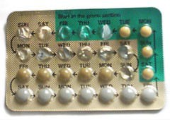
COMBINED PILL.
Contains both
■
Oestrogen (ethyl estradiol/mestranol) 20-
50 Mg.
Progesterone(norethister one, norgestrel) 0.5-2mg.
■
Availability
■
MALA-N (21 Tab) &
MALA-D (28 Tab-7 ferrous fumarate)
Thursday, May 21, 2015

Slide 15
COMBINED PILL
Dosage-
Everyday orally at night for 21 days. ( from 5th day to 25th day of cycle)
7 day break for MALA-N
During this bleeding occurs, which is not menstrual bleeding but is withdrawal bleeding.
MECHANISM OF ACTION.
Prevents Ovulation. Prevents Implantation.
Makes cervical secretions thick & viscid
& prevent entry of sperm in female genital tract.

Slide 16
SEQUENTIAL PILL
High dose of estrogen with moderate dose of progesterone.
Dose – oestrogen 5th- to 15th day, then both oestrogen+progesterone for 5 days.
High incidence of endometrial carcinoma so not used.
MICRO-PILL.
Only progesterone.
Dose – daily through whole of menstrual cycle.
Action – ovulation not inhibited but prevents fertility.
Makes cervical mucosa thick & decrease motility of fallopian tube

Slide 17
POSTCOITAL
Within 72 hrs of unprotected intercourse.
Dose – 2 combined pills immediately followed by 2 pill after12 hrs.
Indication – only in emergency– rape, contraceptive failure, or unprotected sex.
Mechanism of action.
Prevents fertilization & implantation by hypermotility of fallopian tube & uterus.
If ovulation & fertilization occurred then it prevents implantation of blastocyst

Slide 18
OCP
Advantages– 100 % effectivity
Dis-Advantages. –Hypertension. Thromboembolism.
Metabolic effects – diabetes & obesity.
Carcinogenic effect – breast & cervix.
Contra-indications
Women having carcinoma of breast & uterus.
Liver diseases Hyperlipidemia.
Age group above 35 yrs.

Slide 19
DEPOT PREPARATION. INJECTABLE
Oily solutions given intramuscularly.
Progestrin –
Medroxyprogesterone acetate (DMPA) – IM every 3-6 months, 150-400mg.
Norethindrone enanthate (NET-EN) – IM every 3
months , 200 mg.
Combined
Both estrogen & progesterone
IM , monthly
MOA
Prevent ovulation & alter cervical mucosal secretions.

Slide 20
SUB-DERMAL IMPLANTS
Types
Norplant – 6 flexible silastic (silicon) tubes
Norplant 2 – 2 rods of levonorgesterol
Location – beneath skin of arm or forearm.
Contraception – 5-6 yrs.

Slide 21
VAGINAL RINGS.
Contains norgestrel.
Progesterone absorbed through vaginal mucosa.
Advantages – No daily intake Long lasting.
Dis-Advantages
Leads to sterility.
Alterations in menstrual bleeding pattern.

Slide 22
NON-STEROIDAL CONTRACEPTIVES
Centchroman.
Developed by Central Drug Research Institute (CDRI)
Trade name – Saheli
Dose – 30mg twice/week for 12 weeks followed by once in a week
Mechanism of action
Suppress corpus luteal function.
Interfere with motility of fallopian tube
Advantages
Menstrual cycle remains normal.
Complete reversibility after withdrawal

Slide 23
INTRAUTERINE CONTRACEPTIVE DEVICE (IUCD)
Ideal candidate
Has born one child.
Normal menstrual cycle.
No pelvic inflammation.
Ready to check the device
Mechanism of action.
Prevents implantation & growth of ovum.
By aseptic inflammation & causing endometrium not suitable for implantation.
Sperm phagocytization – by neutrophils & macrophages.
Cu affects enzymes, motility
Makes cervical mucus thick prevent entry of sperm.

Slide 24
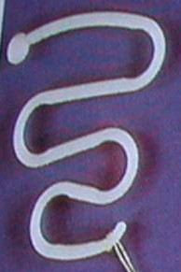
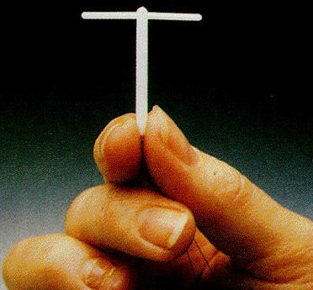
INTRAUTERINE CONTRACEPTIVE DEVICE
(IUCD)
TYPES.
Non-medicated.
■
Medicated.
1ST generation IUCD.
Lippes Loop- serpentine or S shaped.
Made up of Plastic.
2nd generation Cu made 2 types.
Cu T
Cu T 200
Newer like NOVA-7, NOVA-T
■
■
■
■
■
■
■
3rd generation.
■
Hormone releasing containing progesterone reservoir release continuously for 1 yr.
Thursday, May 21, 2015

Slide 25
Cu – T.
Most commonly used .
Made up of Cu.
‘T’ shaped attached with a nylon thread. (tail)

Slide 26
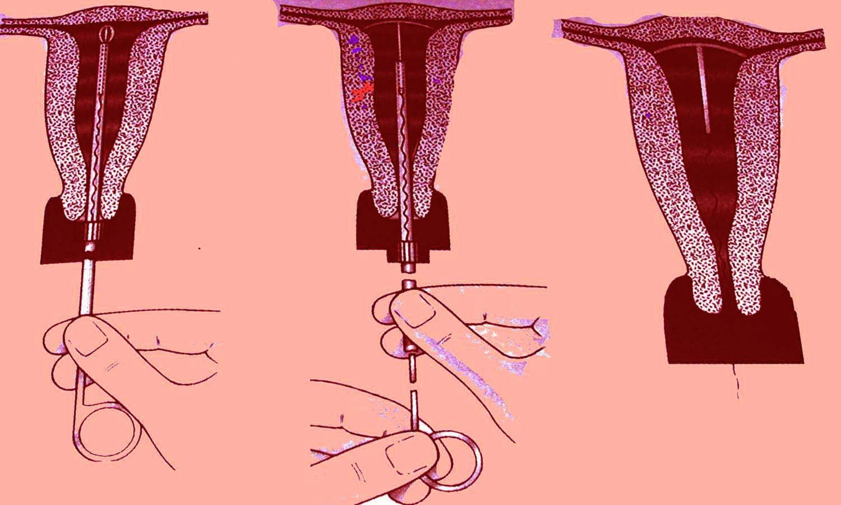
METHOD OF INSERTION.
Withdrawl method.
Ideal time – during mensturation or within 10 days. ( As cervical cavity diameter is more)
Also during 1st after delivery.
Thursday, May 21, 2015

Slide 27
IUCD
Advantages.
Safe Effective Reversible
Easily pulled out when not required.
Long term contraception without adverse effect.
Disadvantages
May cause heavy bleeding.
May come out accidently.

Slide 28
CONTRAINDICATIONS OF IUCD
Suspected pregnancy. Pelvic inflammation.
Heavy bleeding during mensturation.
Suffering from carcinoma cervix.

Slide 29
TERMINAL METHODS
Permanent method.
Indication.
When family is complete.
Medical grounds

Slide 30
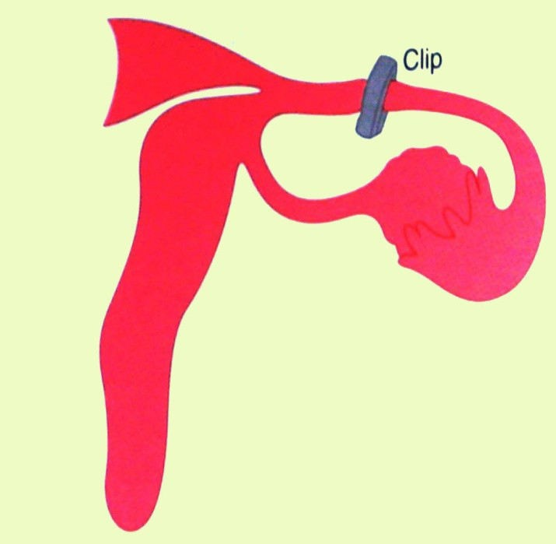
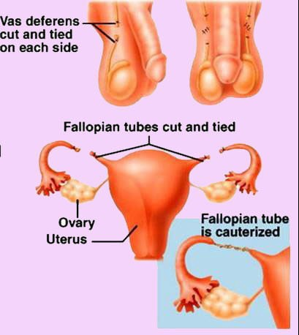
TERMINAL METHODS.
Surgical methods.
1.Tubectomy.
Fallopian tubes identified , cut , cut ends ligated & buried.
2.Laparoscopic occlusion.
■
■
Tubes occluded using silicon rubber bands, rings or clips
Method – quicker, simple, no hospitalization.
■
Thursday, May 21, 2015

Slide 31
MEDICAL TERMINATION OF PREGNANCY
Medical termination of pregnancy or MTP or abortion is allowed under MTP act 1971.
Criteria.
Person who can do MTP
Place where it should be performed.

Slide 32
MEDICAL TERMINATION OF PREGNANCY
Indications.
Medicals – continuation of pregnancy is hazardous to the mother.
Eugenic – substantial risk to the child if born.
Humanitarian ground.– when pregnancy is result of rape.
Failure of contraceptive methods.

Slide 33
PREGNANCY VACCINES
Under experimental trials.
2 types.
Active immunization
Β subunits of HCG – antibodies against beta HCG destroy HCG produced by syncytiotrophoblast.
Tetanus toxoid – increases antigenecity capacity.
Vaccine against Zona Pellucida proteins

Slide 34
CONTRACEPTIVE METHODS IN MALES

Slide 35
METHODS
1. Spacing methods.
Natural.
Barrier.
Chemical.
2. Terminal methods.
3. Miscellaneous methods.

Slide 36
SPACING METHODS
Natural Method ( Coitus Interruptus)
Oldest method of voluntary fertility.
Male withdraws penis before ejaculation into vagina.
Failure rate – high
-As precoital secretions may contain sperm & even a drop is enough to cause fertilization.
-Wrong Timing of Withdrawl

Slide 37
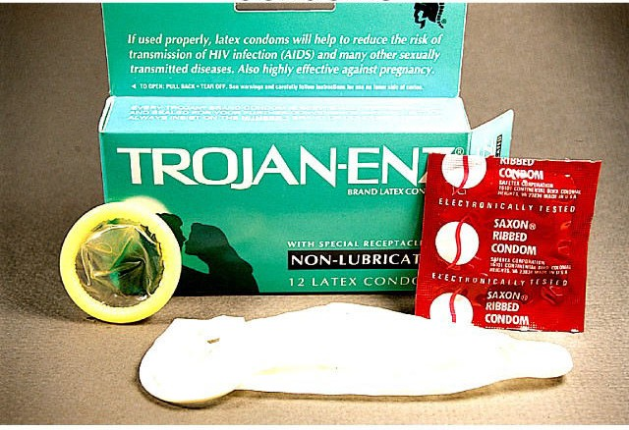
BARRIER METHOD–
Condom
Most widely used.
Made up of fine latex sheath.
Instructions –
❖
Should be worn on erect penis before intercourse.
Air must be expelled
Held carefully when withdrawing from vagina.
A new condom should be used for each sexual act.
NIRODH
❖
❖
❖

Slide 38
BARRIER METHOD
Mechanism of action,
Prevents deposition of semen into vagina.
Advantages –
Easily available , safe, inexpensive
Use dose not require medical supervision. Provide protection against STDs.
Dis-advantage
May slip off or tear off.
Interfere with sexual sensation.

Slide 39
CHEMICAL METHOD
Antispermatogenic Drugs – inhibit spermatogenesis
Male pill (Gossypol) Hormonal preparation
-- Testosterone
-- Testosterone with Danazol
-- Cyproterone acetate
calcium channel blocker-- Nifedipine

Slide 40
MALE PILL ( GOSSYPOL)
Composition – Gossypol, phenolic derivatives of cottonseed oil.
Dose – orally.
200mg/D.– 2 months followed by 60mg/wk.
■
Mechanism of action – exact action not known.
Causes azoospermia.
Advantages – neither hormone nor antihormonal activity
No change in libido & potency.
Disadvantages – permanent azospermic after 6 months
■
■
Thursday, May 21, 2015

Slide 41
HORMONAL PREPARATION
Testosterone
Testosterone with Danazol.
Cyproterone acetate.
Related to progesterone.
Potent anti-androgenic agent.
Causes oligozoospermia & loss of libido.
■
400 mg orally causes azospermia.
■
■
■
Thursday, May 21, 2015

Slide 42
CALCIUM CHANNEL BLOCKERS.
Block Ca channel on cell membrane of sperm.
Prevents Ca influx – membrane becomes rigid & loaded with cholesterol.
Rigid membrane prevents its binding to Zona Pellucida.
So patient on Ca channel blockers (Nifedipine) for hypertension becomes sterile.
Thursday, May 21, 2015

Slide 43
TERMINAL METHODS.
Vasectomy
Vas Occlusion with No-scalpel technique
1.Elastomeric Plugs
2.SHUG
3.RISHUG

Slide 44
MISCELLANEOUS METHODS.
Hot baths.
Hot bath (46⁰ for few weeks.)
Suspensories.
It holds testes close to the body.
Insulated scrotal sack
Thursday, May 21, 2015

